Slide 1

Measure X:
Highway Safety Project Update
Citizens Oversight Committee
February 21, 2023

Slide 2

Measure X Revenue Allocation
Mobility for all
13%
Local Road Repairs
and Safety
60%

Slide 3
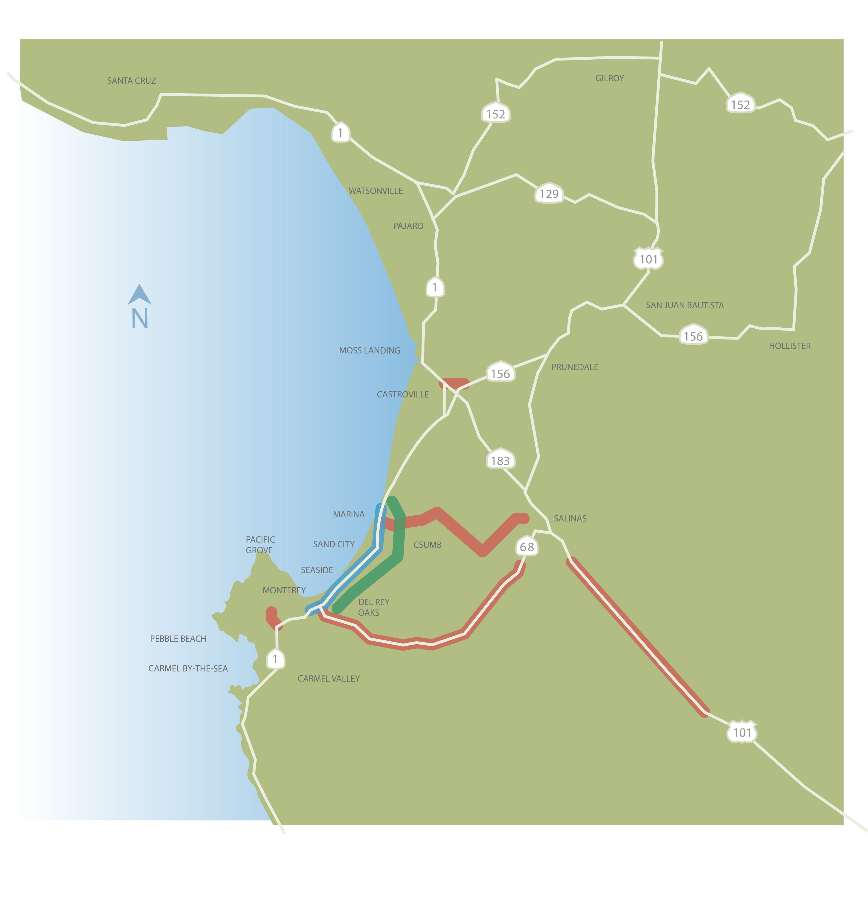
7
2
6
4
5
8
1
3

Slide 4
7
2
6
4
5
8
1
3

Slide 5
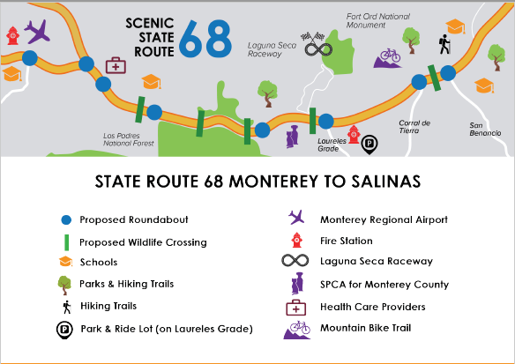

Slide 6
Lead Agency = Caltrans
Environmental: Summer 2024
Design & Permitting: Winter 2026
Begin Construction: Summer 2027
Cost: $260,000,000
Scenic SR 68 Safety & Traffic Flow

Slide 7
7
2
6
4
5
8
1
3

Slide 8
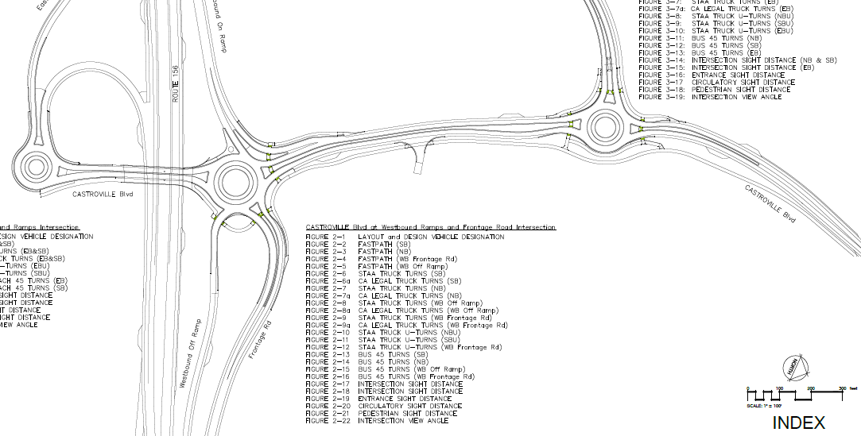
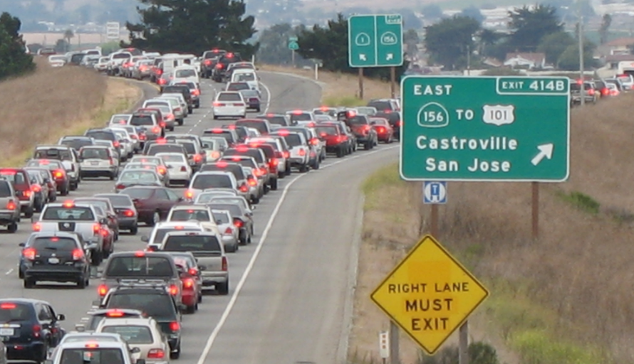

Slide 9
SR 156 / Castroville Blvd Interchange
Lead Agency: Caltrans
Design Completed: Winter ‘22
ROW & Permitting: Spring ‘23
Begin Construction: Winter ‘23
Cost: $55,512,000

Slide 10
7
2
6
4
5
8
1
3

Slide 11
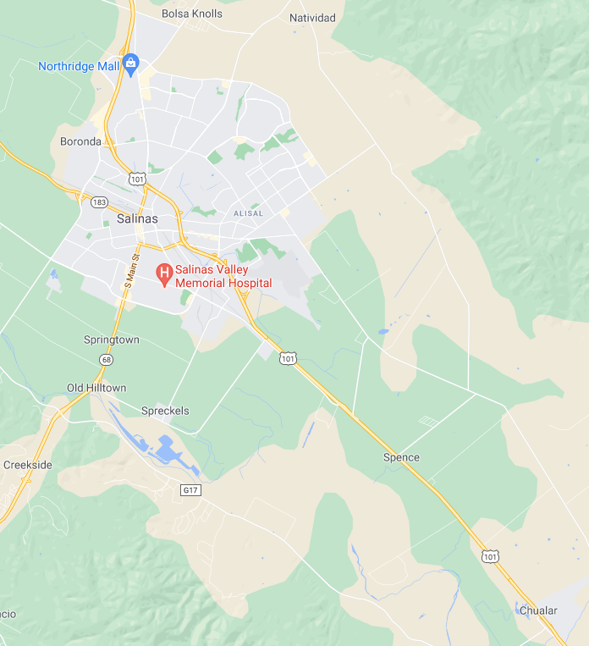
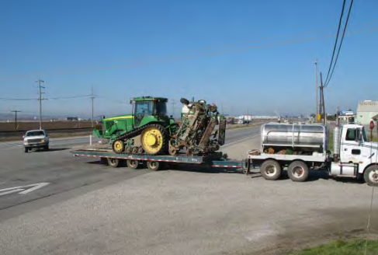
US 101 Safety South County:
Study Area

Slide 12
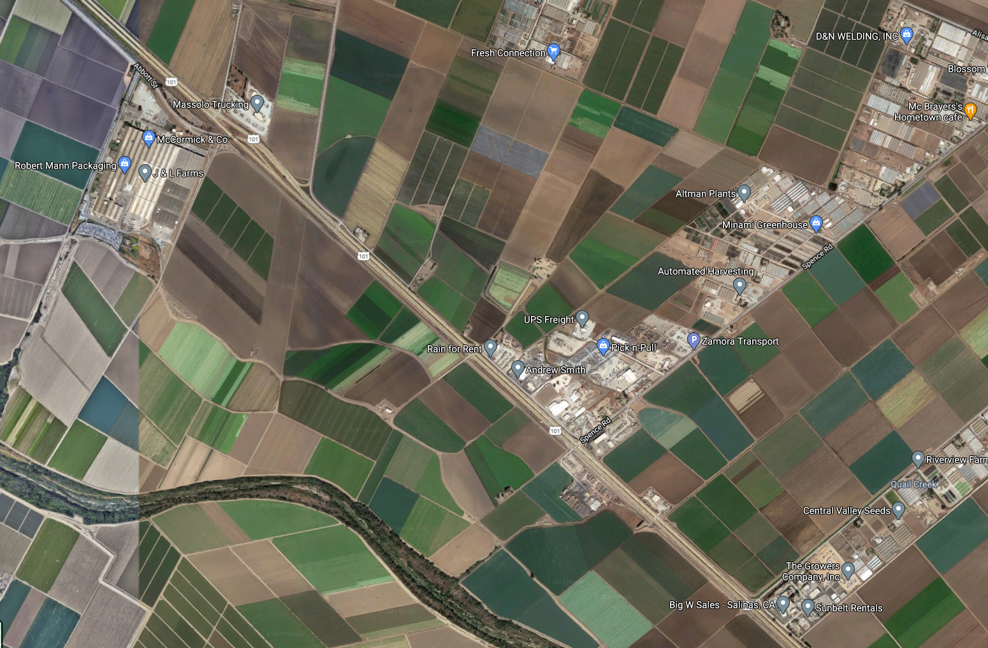

Full Access IC
Full Access IC

Slide 13
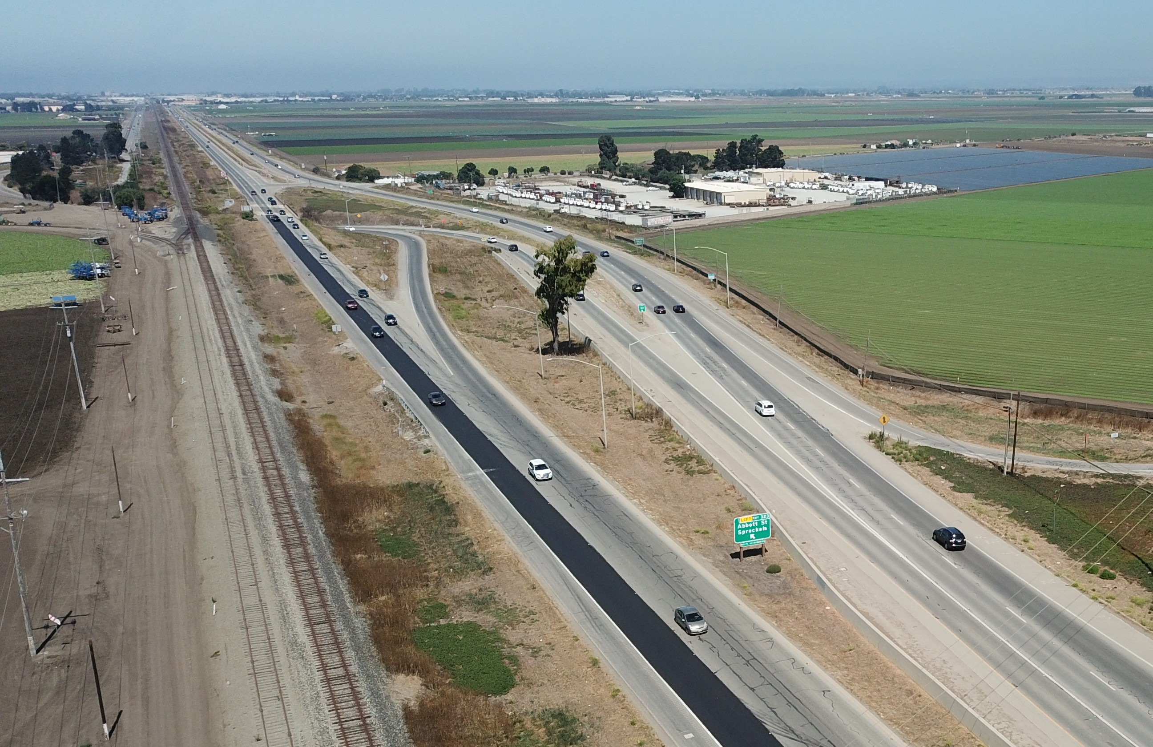
Abbott Street IC

Slide 14
US 101 Safety South County
Lead Agency = Caltrans
Begin Environmental 2022
End Design 2029
Cost: $150,000,000

Slide 15
7
2
6
4
5
8
1
3

Slide 16
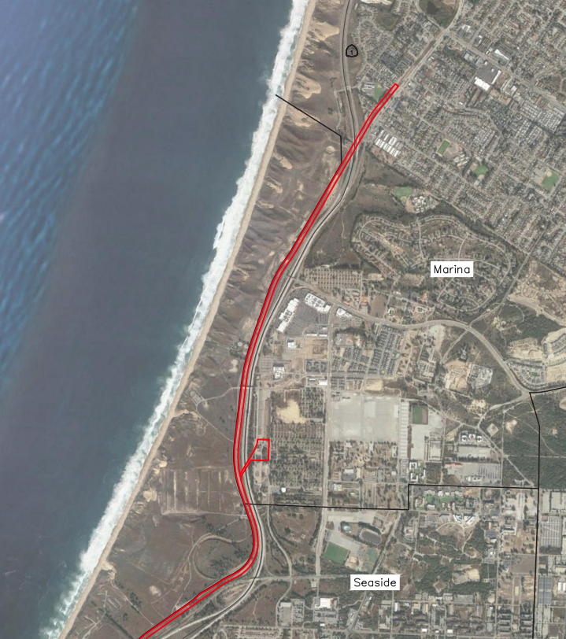
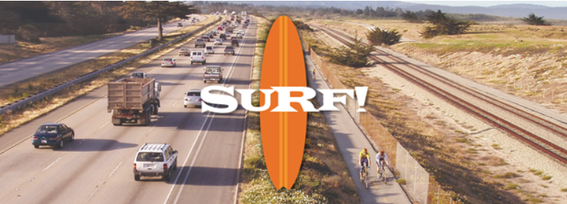
6-mile Bus Rapid Transit (BRT) route along Hwy 1
Links Marina, Fort Ord, Seaside and Sand City
Beach Range Road extension and bike improvements
Monterey Branch Line acquired by TAMC in 2003

Slide 17
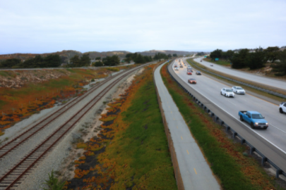

Slide 18
Marina 5th Street Station in Former Fort Ord

Slide 19
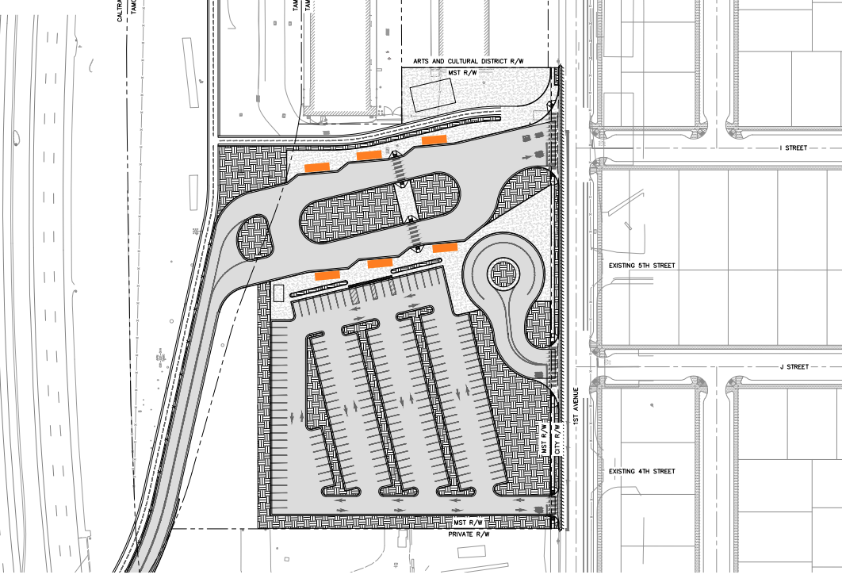

Slide 20
Northern Project Extents in Marina

Slide 21
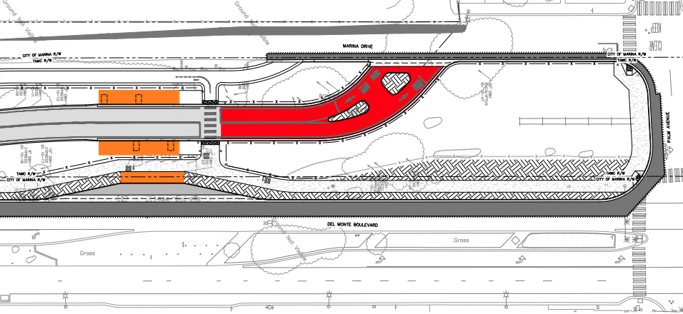

Slide 22
Southern Project Extents in Sand City

Slide 23
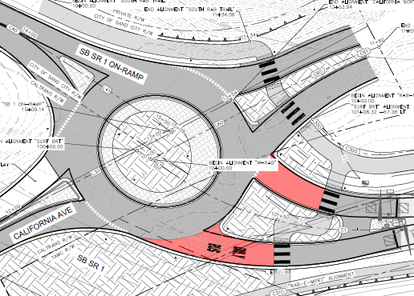

Slide 24
Lead Agency = MST
Complete Design 2022
Begin Construction 2023
Total: $55,769,000
Hwy 1 Rapid Bus Corridor (SURF!)

Slide 25
7
2
6
4
5
8
1
3

Slide 26
Pacific Grove SR 68 Project:
Sunset Dr., Cedar St., and Congress Ave.

Slide 27
7
Questions?
2
6
4
5
8
1
3

