Slide 1


Senior & Disabled Transportation Program
Citizens Oversight Committee | April 18, 2023

Slide 2
Current status of Cycle 2
2 remaining quarters for Cycle 2
$253,925 remaining to date
Grantees have until June 30 to expend all funds
Close out reports and final claims due July 31.

Slide 3
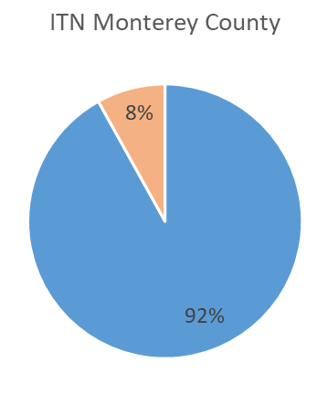
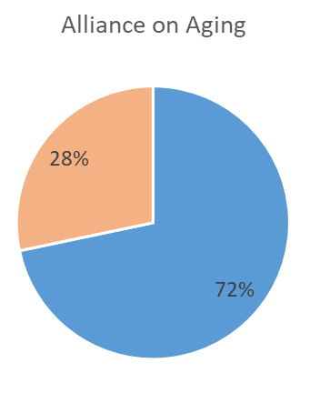
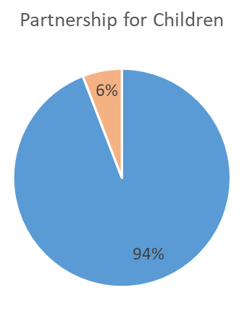
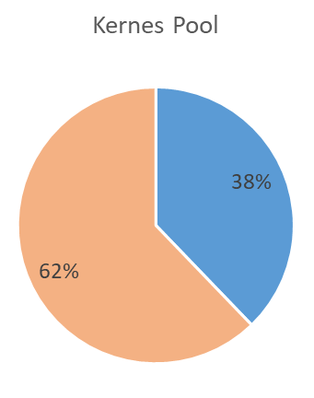
Cycle 2 Funds Remaining
Claimed-to-date
Remaining

Slide 4
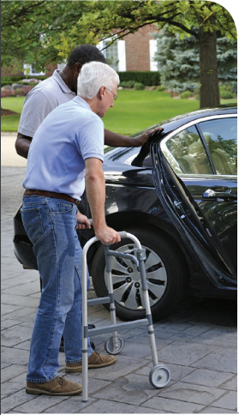
Cycle 3
$1.5 million available for Cycle 3
Fiscal Years 23/24, 24/25, 25/26
5 complete applications submitted by due date of December 1, 2022

Slide 5

Grant Review Committee
Paula Getzelman
                Diana Jimenez
                Kevin Dayton (Site Visits)
                Theresa Wright
                Aaron Hernandez
Each member were to visit at least 2 sites

Slide 6

Ranking Criteria – 100 Points Possible
Program Purpose & Goals: 25
Program Benefits: 30
Feasibility: 15
Geographic Equity: 15
Cost Effectiveness: 15

Slide 8

Partnership for Children
Grant Award $345,503.76
Project
Transportation Services for Children Living with Serious Illness
Notes:
Provide direct-ride services and gas subsidy services for medical appointments to families of children living with serious illness.

Slide 9
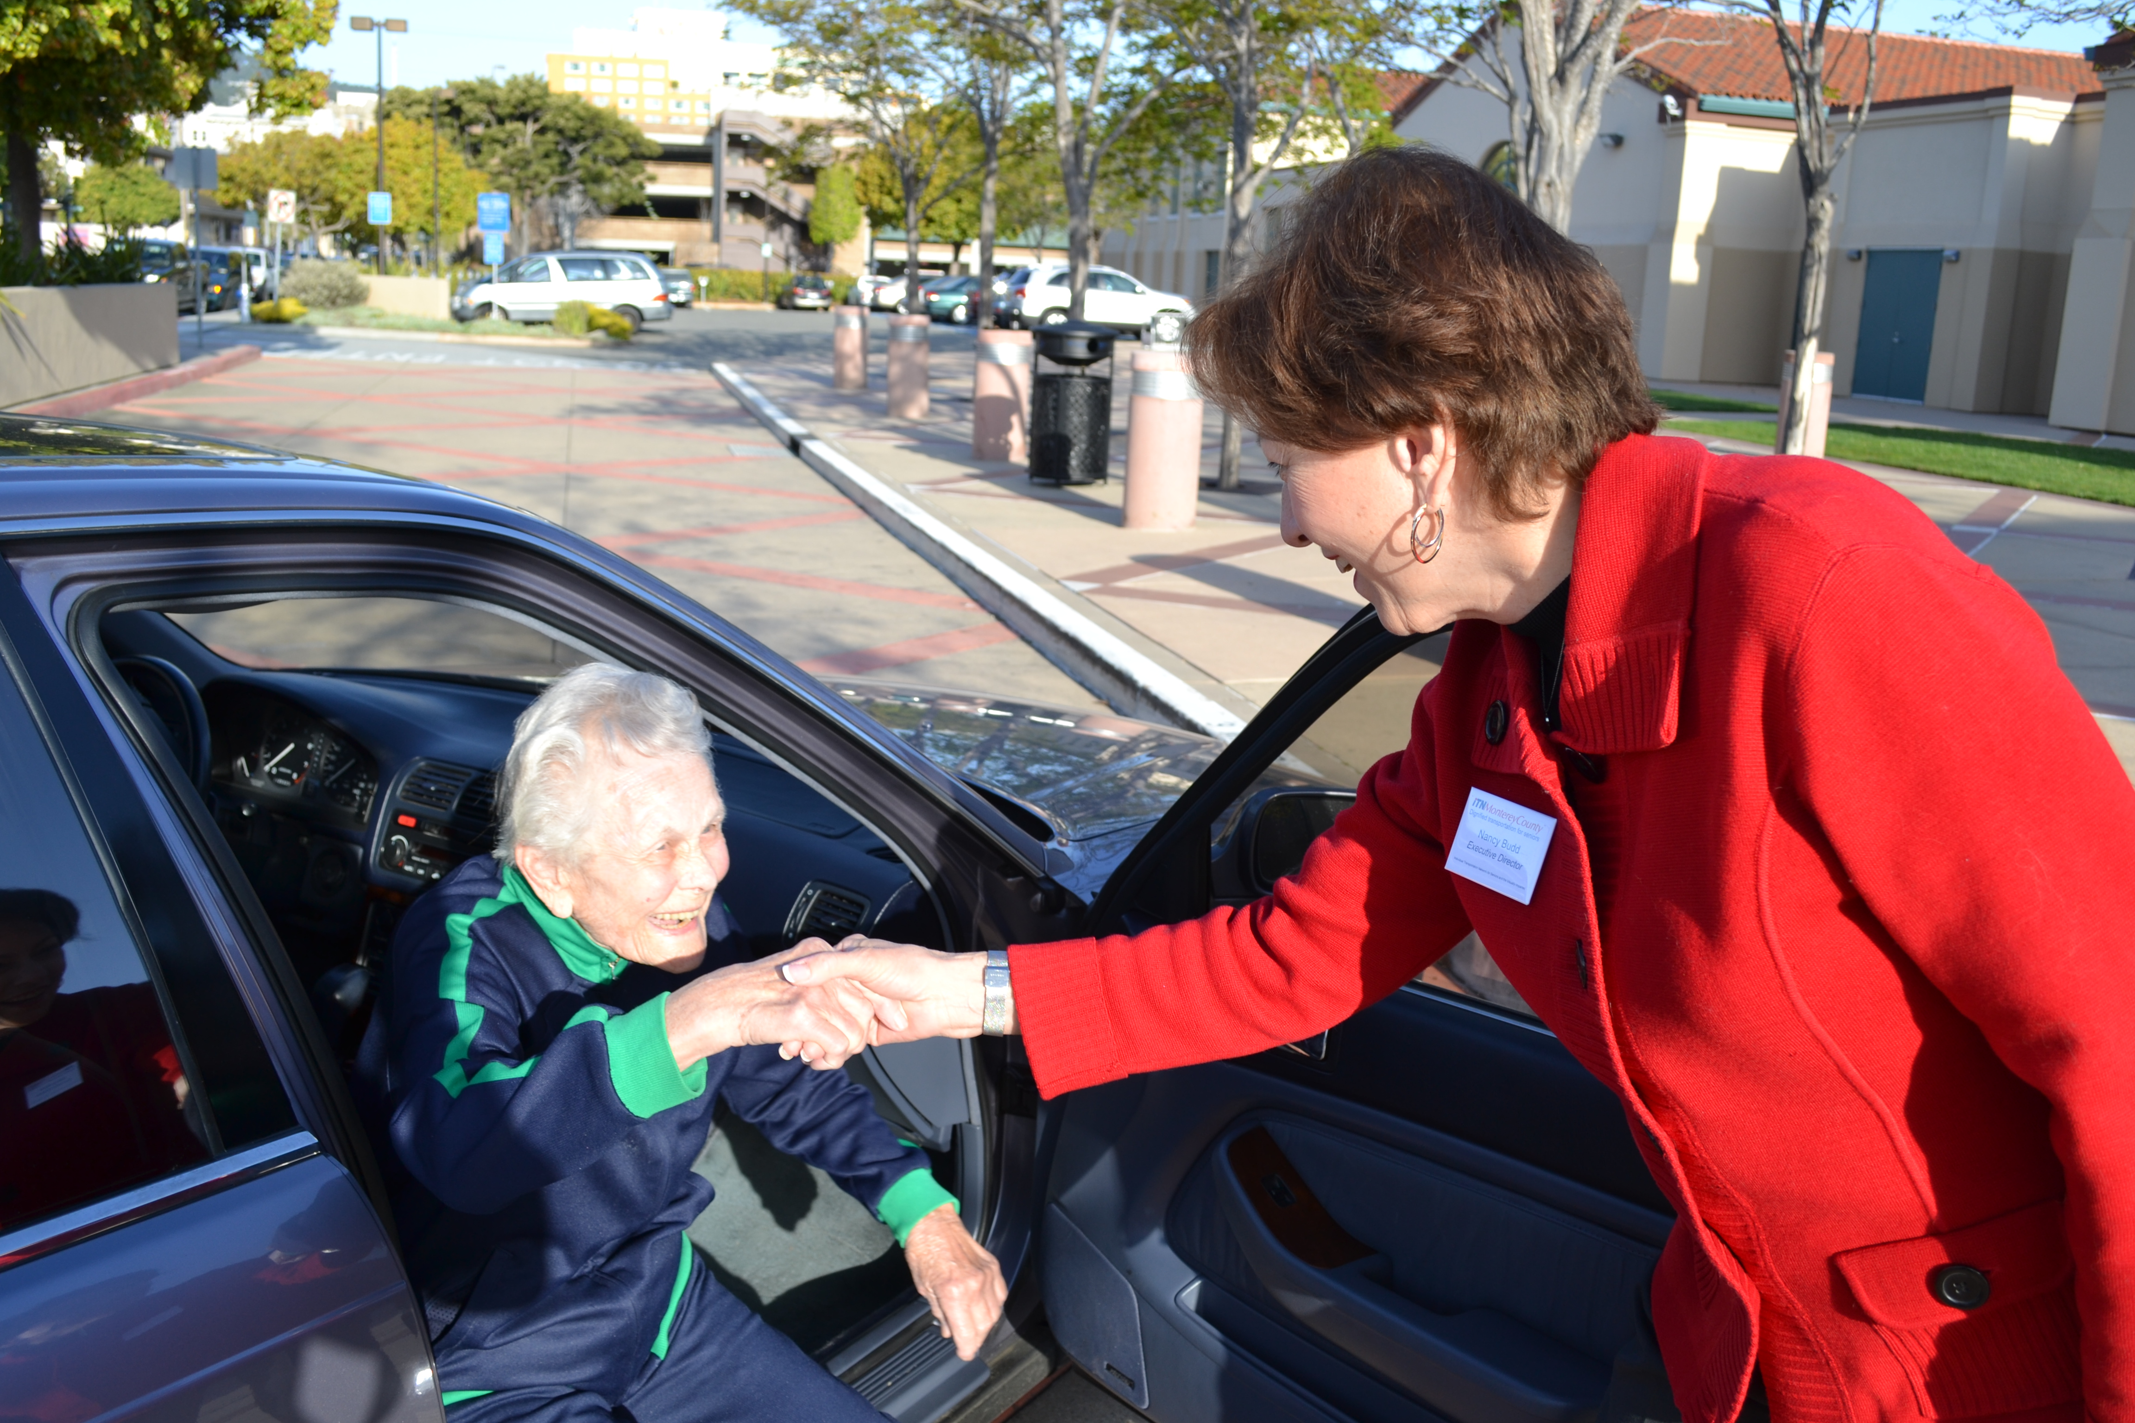
ITN Monterey County
Grant Award $705,263
Project
Expanding Dignified Transportation in Monterey County for Seniors, Veterans, and Visually Impaired Adults
Notes:
Provide 24 hours/7 days-a-week, arm through-arm, door-through-door transportation to help seniors, veterans, and visually impaired adults to remainn

Slide 10
Alliance on Aging
Grant Award $227,819
Project
Senior Transportation Coordination Project – Phase 3
Notes:
Senior Transportation Specialist Program, including trainings, transportation information, individual support, ensure advocacy efforts to increase transportation services South and North Monterey County and assess service needs in Carmel Valley and Big Sur Coast.

Slide 11
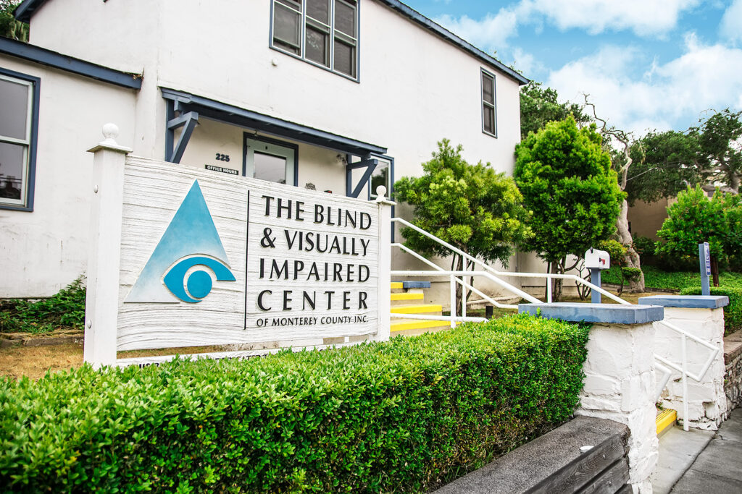
Blind & Visually Impaired Center
Grant Award $142,643
Project
Orientation and Mobility Trainings
Notes:
Engage with more clients in Salinas and South County, increase service hours, hire an additional orientation and mobility specialist, train clients to utilize various modes of transportation, and open an additional office in Soledad.

Slide 12
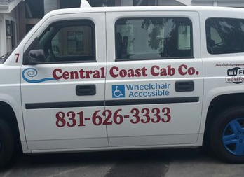
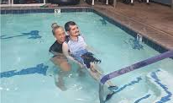
Kernes Memorial Pool
Grant Award $78,770
Project
Transportation for Seniors and People with Disabilities to Receive Therapeutic Aquatic Services
Notes:
Trip subsidy program to provide low and very low income senior and disabled residents in Monterey County with reliable transportation services to enable them to attend therapeutic aquatic appointments.

Slide 13
RECOMMEND that the Board award Measure X Senior & Disabled Transportation Cycle 3 funds as follows:
$345,504 to Partnership for Children,
$705,263 to Independent Transportation Network (ITN) Monterey County
$227,820 to Alliance on Aging
$142,644 to Blind & Visually Impaired Center, and
$78,770 to Kernes Memorial Pool; and
RECOMMEND that the Board approve an extension to the deadline for Kernes Memorial Pool to use their Cycle 2 funding by one year from June 30, 2023 to
June 30, 2024

