Slide 1
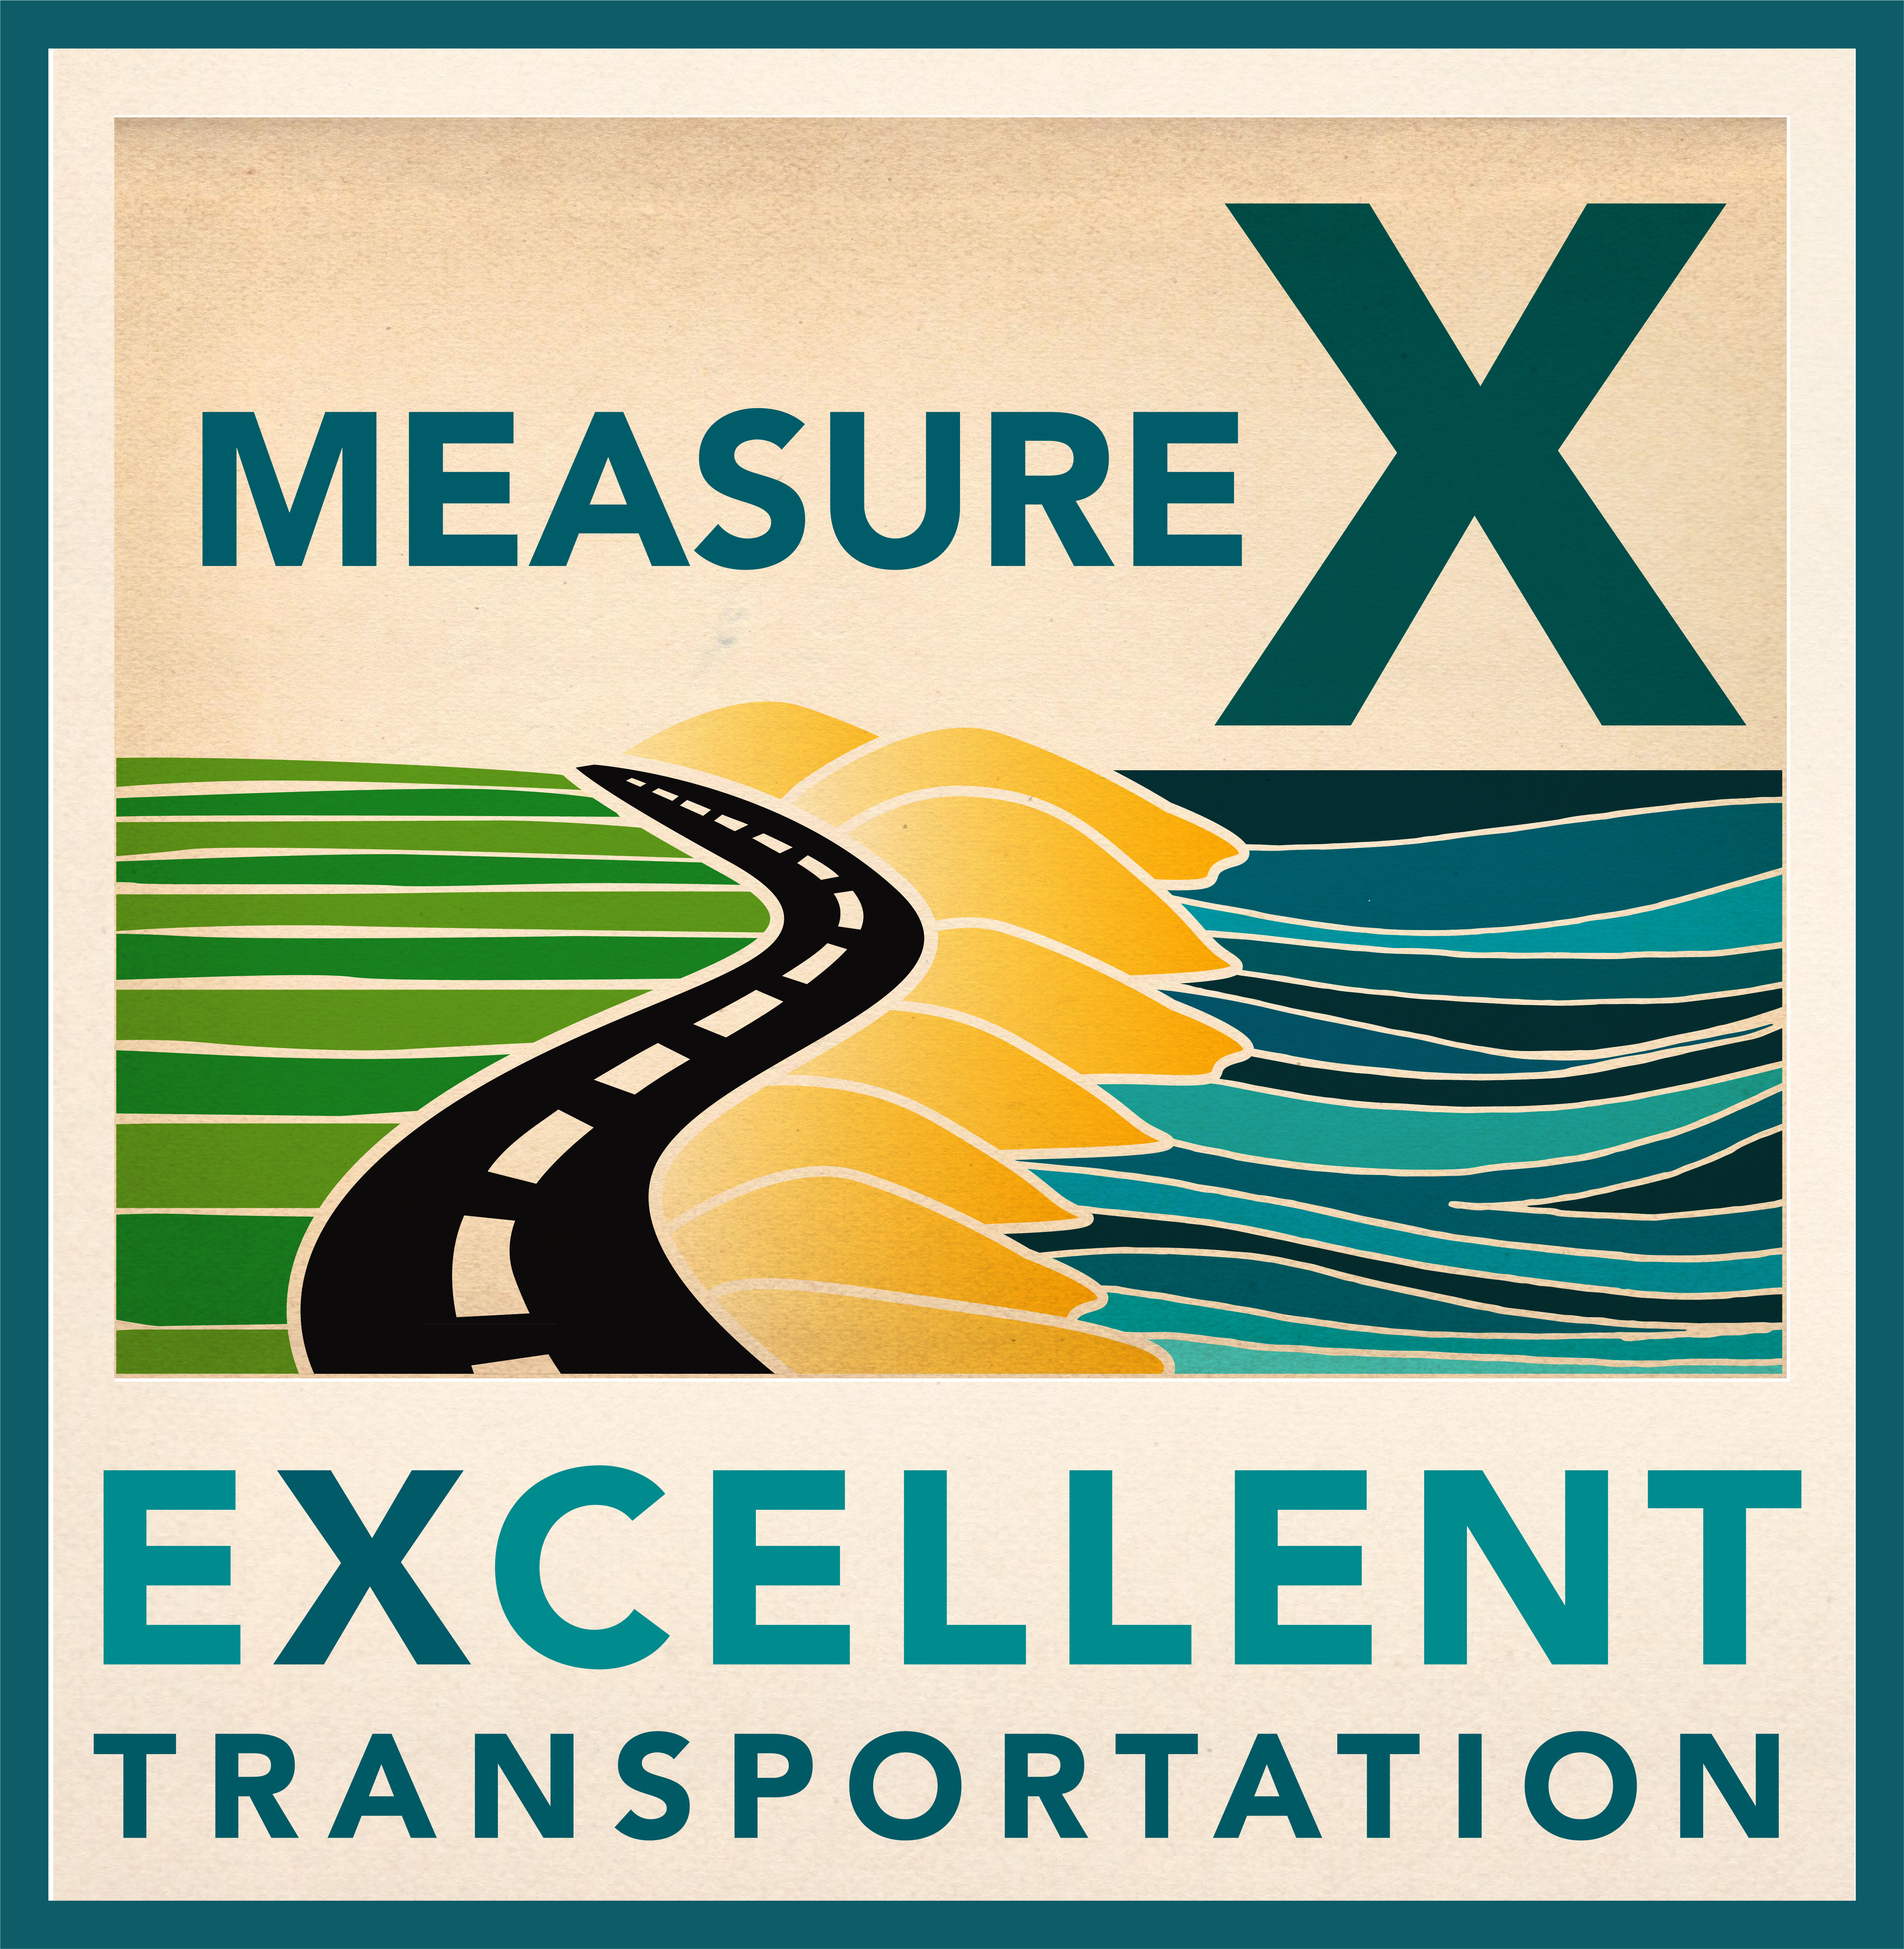
Measure X Revenue Update
Board of Directors
September 27, 2023

Slide 2
Measure X Revenue Estimates

Slide 3
Regional Measure X Leveraging

Slide 4
Measure X Investment Plan Policies
Use of Excess Revenues
If a five-year average of revenues exceeds the estimates in this plan, funding may be allocated in this order of priority by the TAMC Board:
To cover cost increases or new features of projects on the list;
To incorporate new technologies into the plan; and,
To add new projects to the list.

Slide 5
Measure X Investment Plan Policies
Funding or Cost Changes
There are many unforeseen circumstances that can arise over 30 years. The actual funding needed to construct the regional roadway projects may be higher or lower due to factors that are outside their control. The effects of inflation or rising construction costs may impact the total amount of funding needed to complete the projects. As such, the project funding shares in this plan will be revised annually to account for inflation.

Slide 6
Inflation Adjustments
 | FY 2017/18 | FY 2022/23 | FY 2023/24
Projects |  | 7.34% | 4.93%
Highway 68 Safety & Traffic Flow | $50 | $57.69 | $60.53
US 101 Safety Improvements - South County | $30 | $34.61 | $36.32
State Route 156 Safety Improvements | $30 | $34.61 | $36.32
Imjin Safety & Traffic Improvements | $20 | $23.07 | $24.21
Highway 1 Rapid Bus Corridor | $15 | $17.31 | $18.16
Holman Highway 68 Safety & Traffic Flow | $10 | $11.54 | $12.11
Habitat Preservation / Advance Mitigation | $5 | $5.77 | $6.05
Programs
FORTAG | $20 | $23.07 | $24.21
Safe Routes to Schools | $20 | $23.07 | $24.21
Senior & Disabled Transportation | $15 | $17.31 | $18.16
Commuter Bus | $25 | $28.84 | $30.27
Total Regional Program | $240 | $277 | $291

Slide 7
Questions?
Mike Zeller
Director of Programming & Project Delivery
mike@tamcmonterey.org

