Slide 1
SR 156 / Castroville Boulevard Interchange Project
Transportation Agency Board of Directors
May 24, 2023

Slide 2
Highway 156 Corridor Projects
Segment 1 Castroville Blvd Interchange
$42,500,000
Segment 2
Route 156 to Four Lanes
$106,225,000
Segment 3
US 101 Interchange
$250,890,000

Slide 3
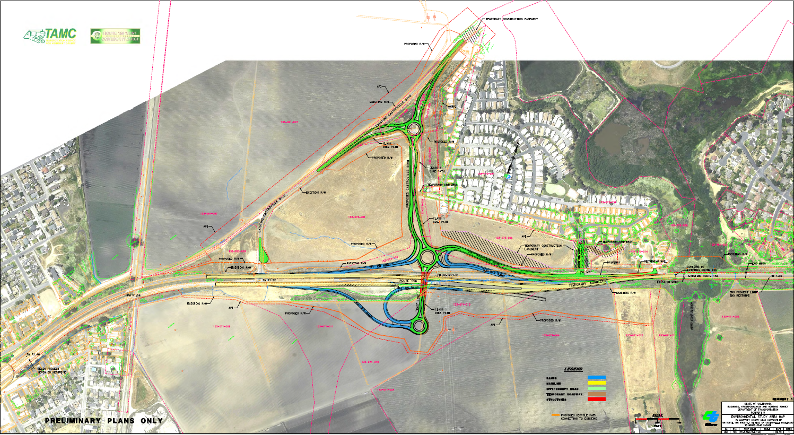
Notes:
Project Description from the meeting agenda:
Coastal Development Permit to allow three roundabouts as Phase I of the State Route 156 Interchange project to replace the existing Castroville Boulevard signalized intersection. These roundabouts will connect SR 156 with Castroville Boulevard. The project will also provide a new Class 1 mixed use bicycle and pedestrian path, driveways and on and off ramps associated with the three new roundabout structures.
Project Description from the CDP application:
The proposed project will construct a series of three roundabouts to replace the existing Castroville Boulevard signalized intersection. Roundabouts one and two will be connected by an overcrossing above the existing State Route (SR) 156. Roundabouts two and three will be connected by a new road running north/south connecting Castroville Boulevard with SR 156. The project will also work to provide a new Class I mixed use bicycle and pedestrian path, driveways, and on and off ramps associated with the tree new roundabout structures. The project will be constructed in a series of eight stages to ensure there is public access to the high school and community adjacent to the project. The project has the potential to impact Coastal Scrub, riparian habitat, wetlands, California tiger salamander, Santa Cruz long-ted salamander, the California red-legged frog. Removal of eucalyptus, pine, and oak trees is anticipated at two locations on the project site with additional impacts to arroyo willow trees expected near the Santa Cruz long-toed salamander pond. The project also anticipates impacts to approximately 23 acres of farmland. Mitigation plans will be developed to address both coastal agricultural/farmland impacts and coastal biological resource impacts.

Slide 4
Project Challenges
Legislation needed for take of fully protected Santa Cruz Long Toed Salamander
New Route Adoption and Freeway Agreement needed between Caltrans and the County
Working with Coastal Commission on Coastal Development Permit
Finding properties for Agriculture, Wetland, Species mitigation
Utility relocation still pending
Rising construction prices

Slide 5
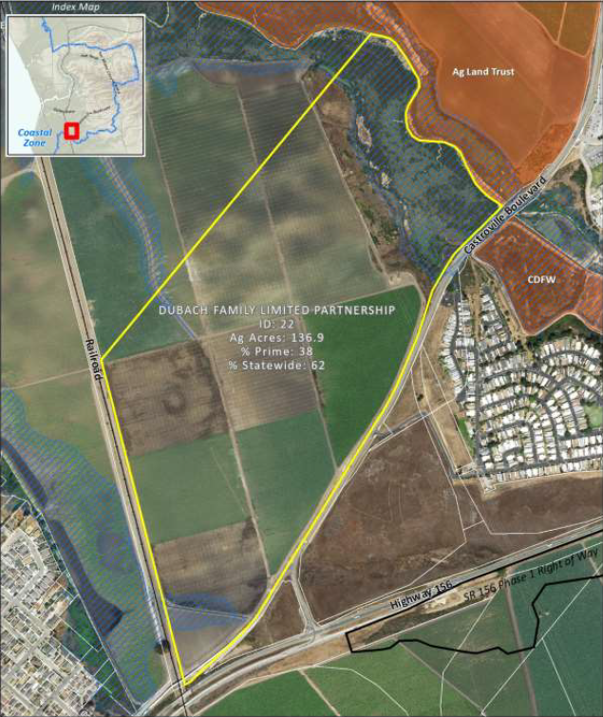
Current Status
Project Plans and Estimate are complete
Coastal Development Permit issued
Army Corp (Wetland impacts) permit issued
Agriculture mitigation property (Dubach) purchased
CDFW permit pending
Utility relocation pending

Slide 6
Utility Relocation
Seven different Utility Companies have facilities needing to be relocated
Three of those utilities are PG&E branches: Electric Transmission, Gas Transmission, Electric Distribution
Right of Way staff has successfully worked with 5 of the utilities on relocation plans
PG&E Gas Transmission has given an 18-month lead time on completing relocation plans – will be done by December 2023
PG&E Electric Distribution has been unresponsive, initial contact made with PG&E ED in October 2021, PG&E assigned a PM on March 2023

Slide 7
Project Funding
Original Programmed Construction Capital: $24,000,000
Current Engineer’s Estimate: $42,500,000
Reasons for major increase in Capital Cost:
Increased unit costs for contract items
Import Borrow needed due to unsuitability of existing soil
Additional Environmental Mitigation
Vertical drains for soil Settlement

Slide 8
Project Schedule
June 2023: CTC Meeting to approve Allocation
Dec 2023: Final PG&E Plans
Jan 2024: Right of Way Cert and RTL
April 2024: Advertise Project
May 2024: Bids Open
June 2024: Contract Award
June 2023: CTC Meeting to approve At-risk Allocation
December 2023: Final PG&E Plans submitted
January 2024: Right of Way Certification and Ready to List (RTL)
April 2024: Advertise Project
May 2024: Bids Open
June 2024: Contract Award

Slide 9
Determining Share of $18M Cost Increase
Original Project Funding Breakdown
 | Totals | TAMC | Caltrans | Split
CON Capital | $24,000 | $13,537 | $10,463 | 56/44
CON Support | $5,500 | $1,531 | $3,969
CON Total | $29,500 | $15,068 | $14,432 | 51/49
At 56%, TAMC’s share of cost increase is $10,361,000
At 51%, TAMC’s share of cost increase is $9,383,000

Slide 10
Requested Action
APPROVE programming up to an additional $10,361,000 of Regional Measure X funds to cover TAMC’s share of the increased estimated costs; and
DIRECT staff to continue negotiations with Caltrans over the cost share percentages.

