Slide 1
2024 Regional Transportation Improvement Program
Board of Directors
October 25, 2023

Slide 2
State Transportation Improvement Program
State and Federal Gas Tax
5-year fund cycle
FY24/25 – FY28/29
Monterey County share: $15.515 million
Regions submit updates every 2 years in December
Adopted by the California Transportation Commission in March

Slide 3
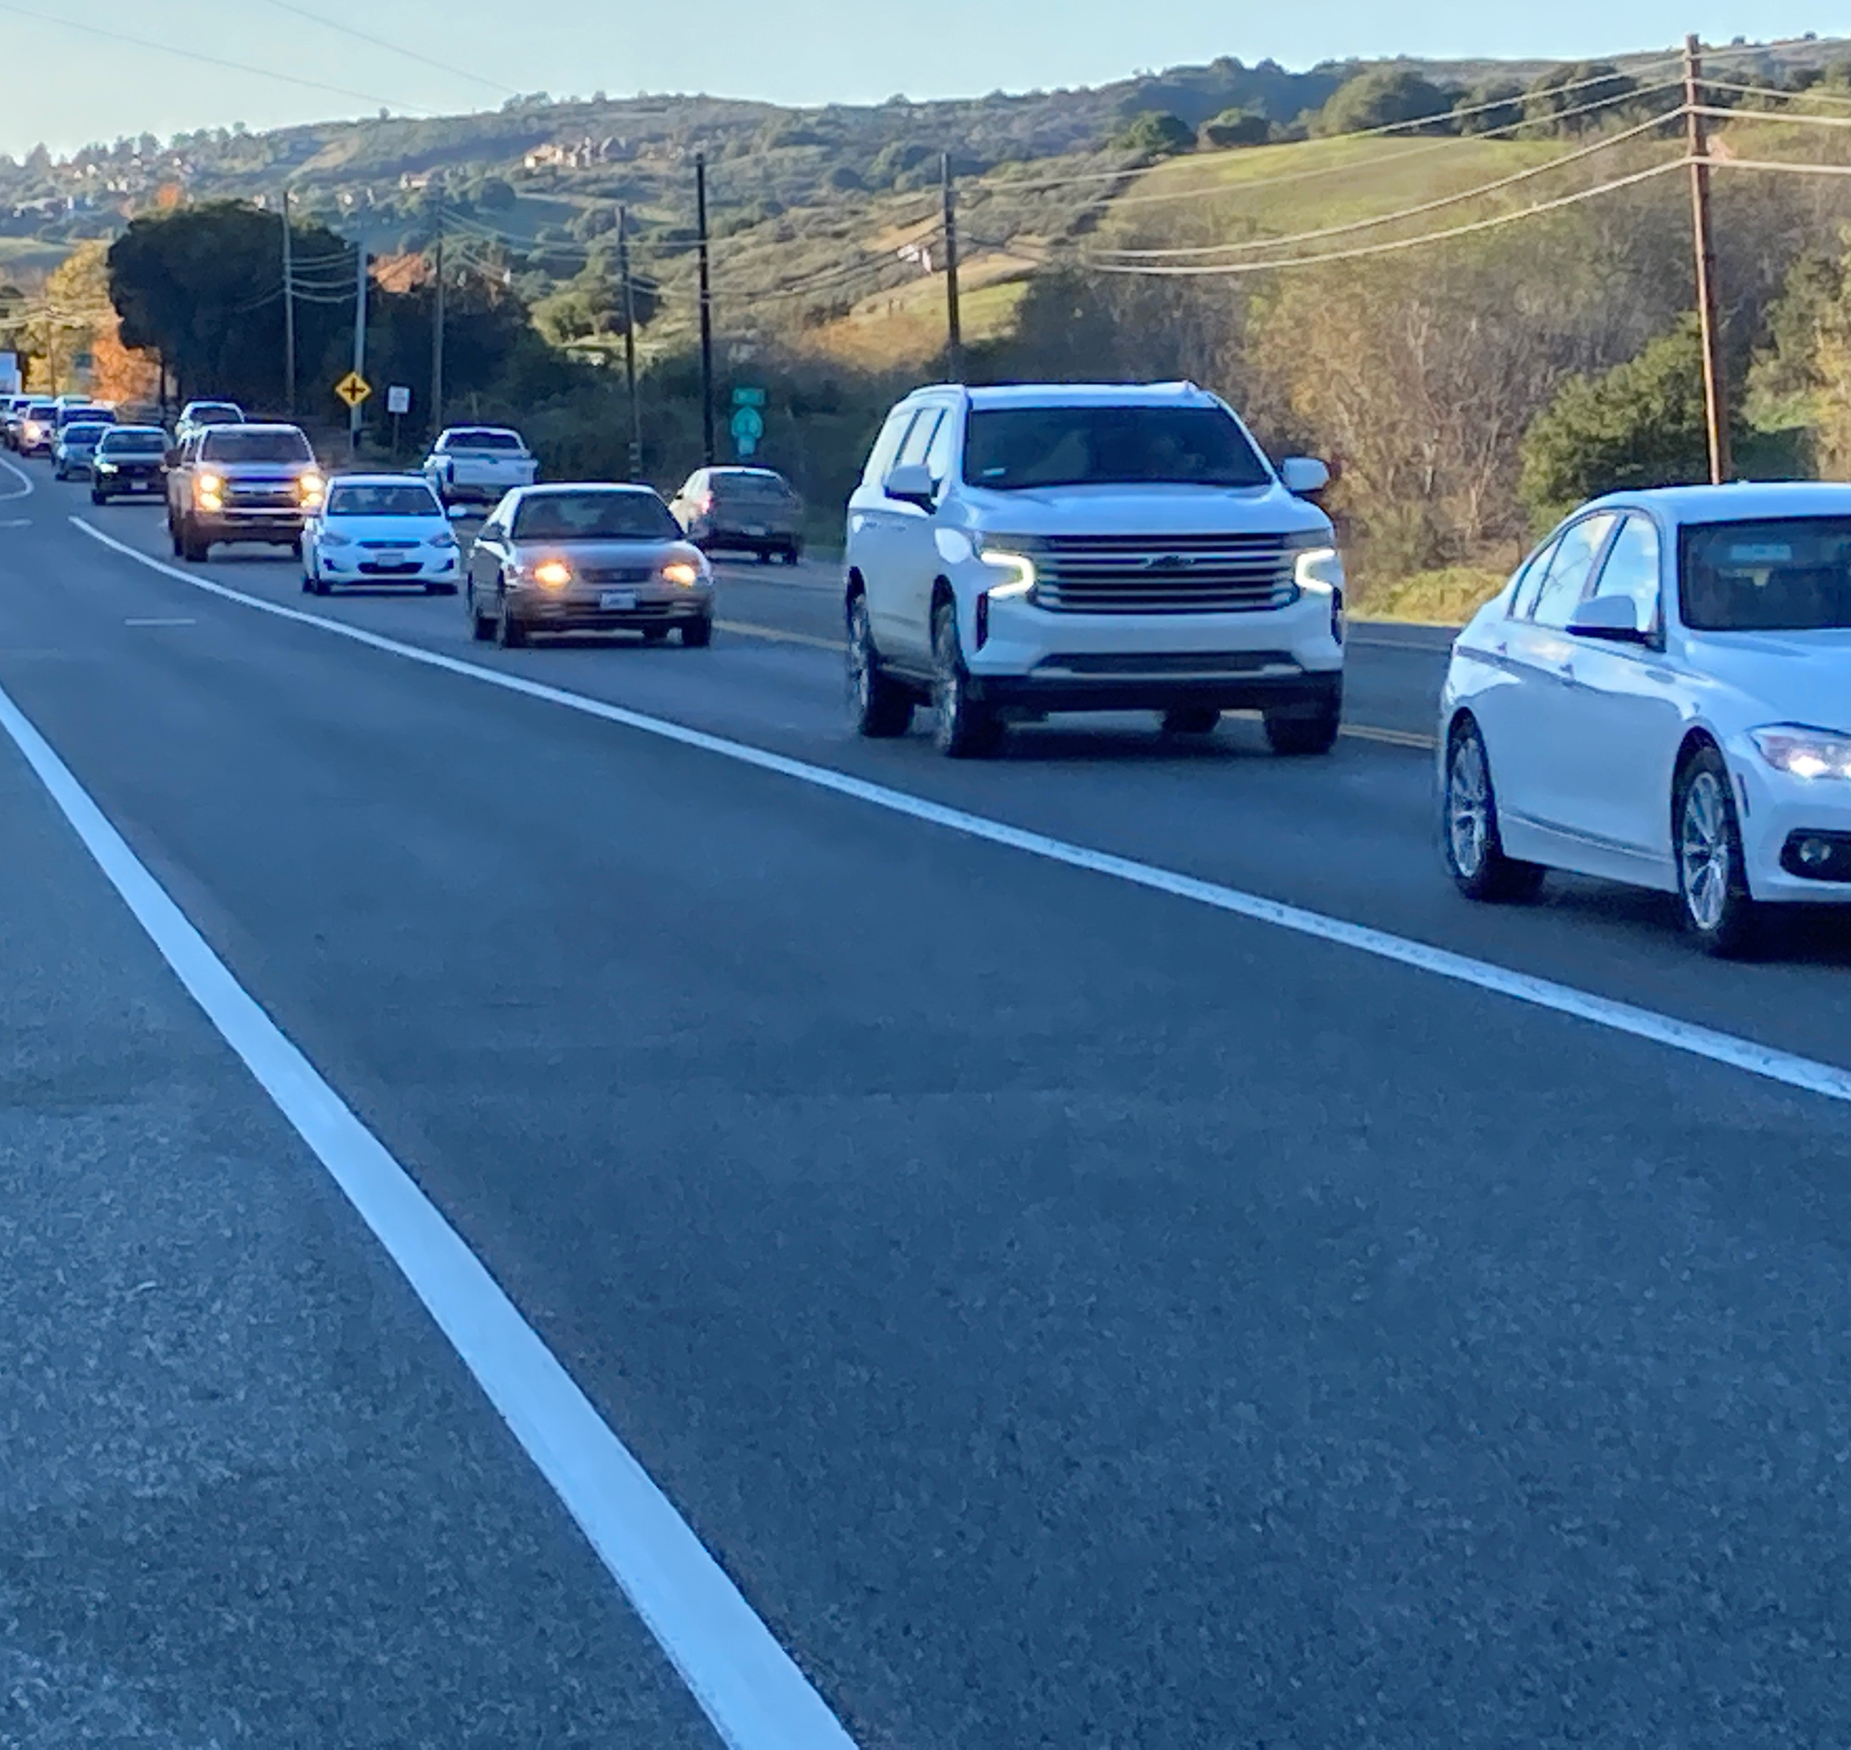
Regional Transportation Improvement Program
Regionally-significant transportation projects
Integrated Funding Strategy considers fund sources and program requirements
Advance projects
More flexibility with Caltrans managed projects

Slide 4





Scenic State Route 68
 | Prior | 24/25 | 25/26 | 26/27 | 27/28 | 28/29
 | Env’t |  | Design | Con
State Transportation Improvement Program – 2022 | $5,487 |  | $23,516
Highway Infrastructure Program | $2,594
Measure X | $640 |  |  | $6,300
SB1 Local Partnership Formula – FY20/21-22/23 | $1,949
Highway Infrastructure Program – FY19/20-20/21 | $799
Congested Corridors Grant Request |  |  |  | $50,400
State Transportation Improvement Program - 2024 |  |  |  | $6,300
Total: $97,985 | $11,469 |  | $23,516 | $63,000
2024 Regional Transportation Improvement Program – Staff Proposal

Slide 5

US 101 South County
 | Prior | 24/25 | 25/26 | 26/27 | 27/28 | 28/29
 |  |  | Design
Measure X | $440 |  | $8,036
State Transportation Improvement Program – 2022 | $9,989
State Transportation Improvement Program - 2024 |  |  | $8,964
Total: $27,249 | $11,469 |  | $17,000
2024 Regional Transportation Improvement Program – Staff Proposal

Slide 6
Planning, Programming, & Monitoring
 | Prior | 24/25 | 25/26 | 26/27 | 27/28 | 28/29
State Transportation Improvement Program – 2022 | $916 | $202 | $197 | $196
State Transportation Improvement Program - 2024 |  | $75 | $80 | $81 | $276 | $253
Total: $2,276 | $916 | $277 | $277 | $277 | $276 | $253
2024 Regional Transportation Improvement Program – Staff Proposal

Slide 7
Timeline
Task | Schedule
2023 Integrated Funding Strategy | May 2023
Draft 2024 STIP Fund Estimate Released | June 2023
Draft 2024 STIP Fund Estimate Adopted | August 2023
Staff Funding Proposal to Exec & Board | October 2023
Regional Transportation Improvement Program Adopted | December 2023
2024 Regional Transportation Improvement Program – Staff Proposal

Slide 8
Thank you!
Janneke Strause, Transportation Planner
Janneke@tamcmonterey.org
(831) 775-4410

