Slide 1
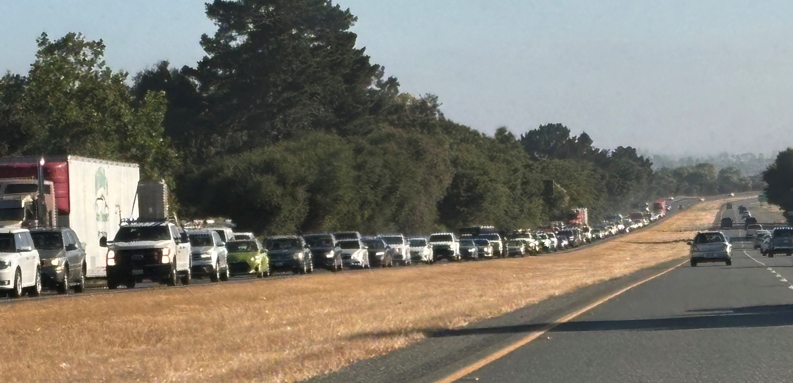
Toro Park Pilot Project Doug Bilse, TE Project Manager
Notes:
How many were here October 8?
Review attendance dots

Slide 2
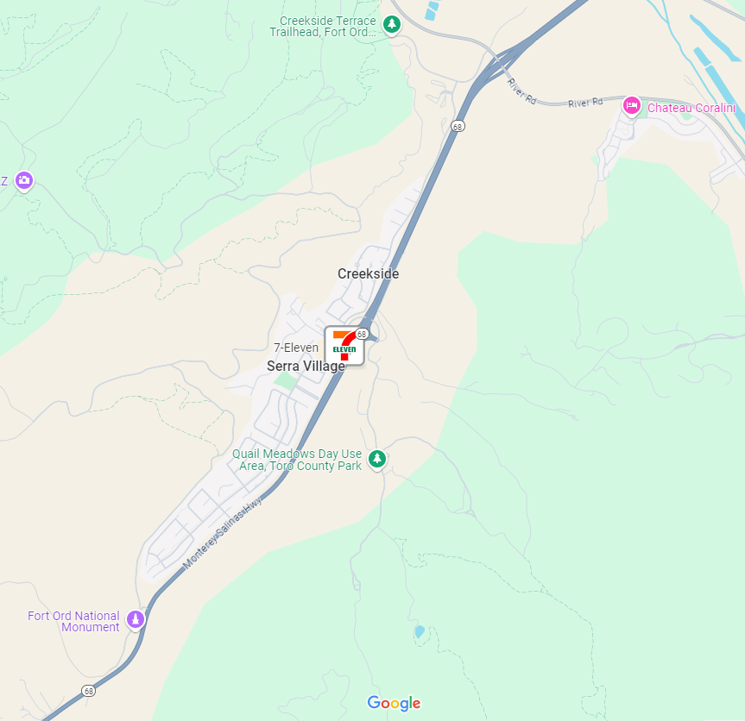
Toro Park Pilot Project
Severe Hwy 68 Congestion=
Cut-Thru Traffic

Slide 3
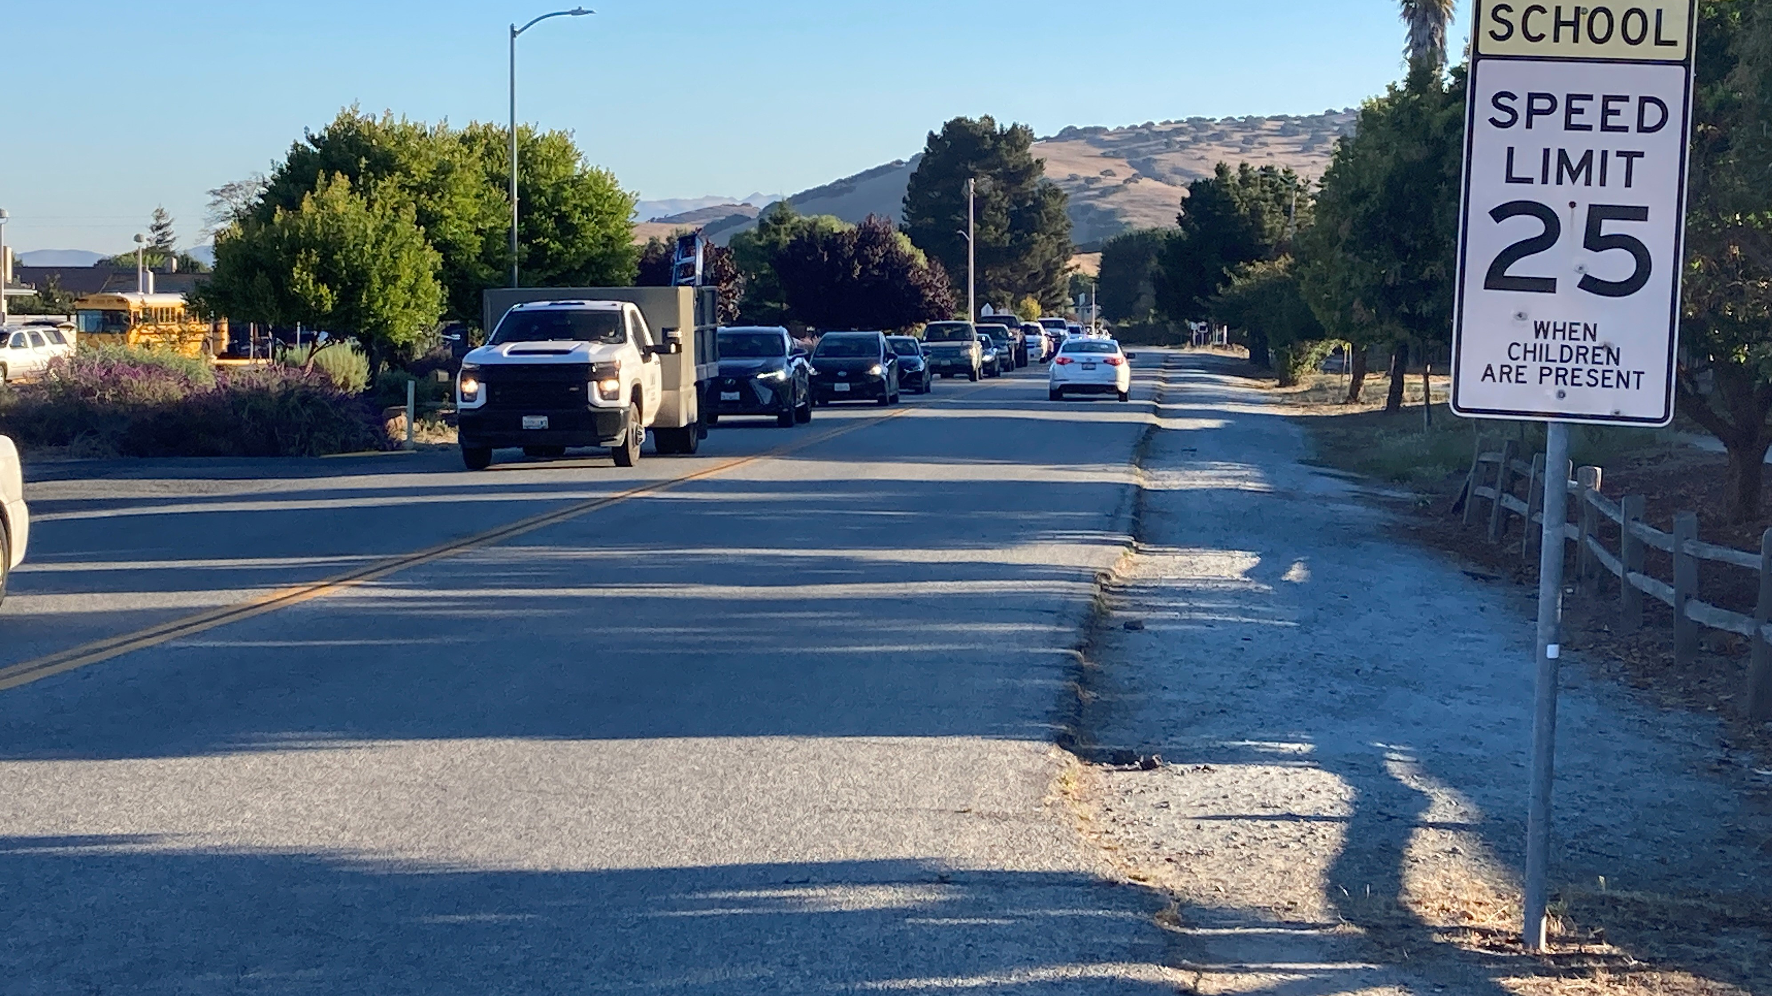
Portola Drive Cut-Through Traffic

Slide 4
Toro Park Pilot Project
Severe Portola Congestion=
Cut-Thru
Cut-Thru Traffic

Slide 5
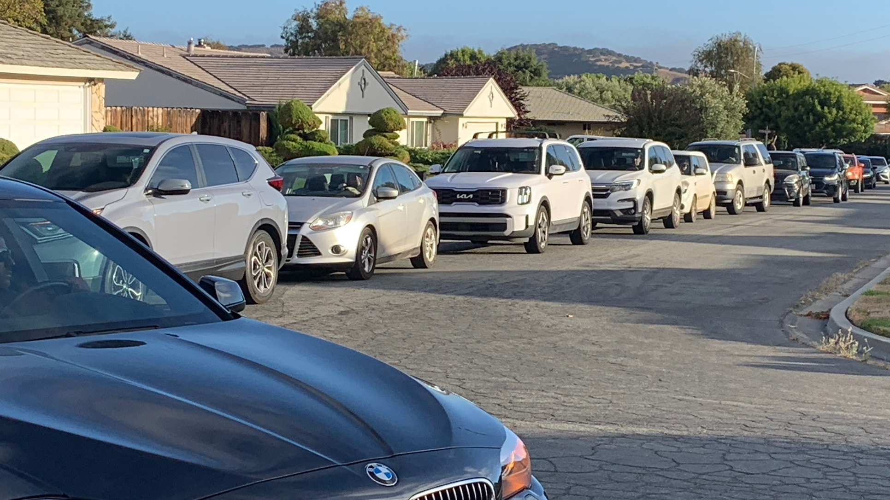
Cut-Through Cut-Through Traffic

Slide 6
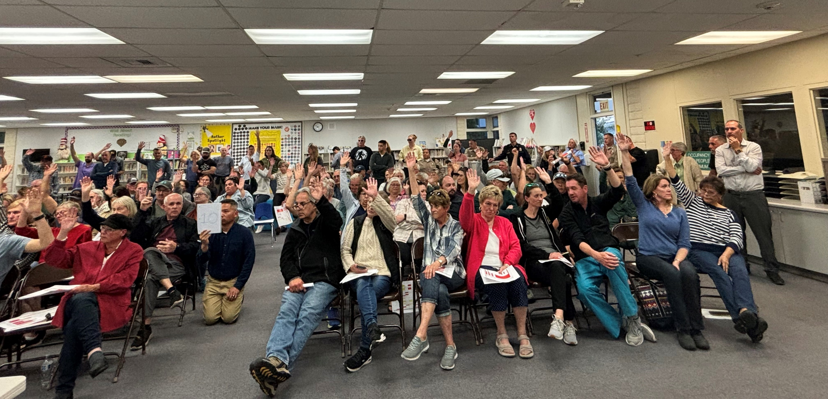
Call to action!

Slide 7
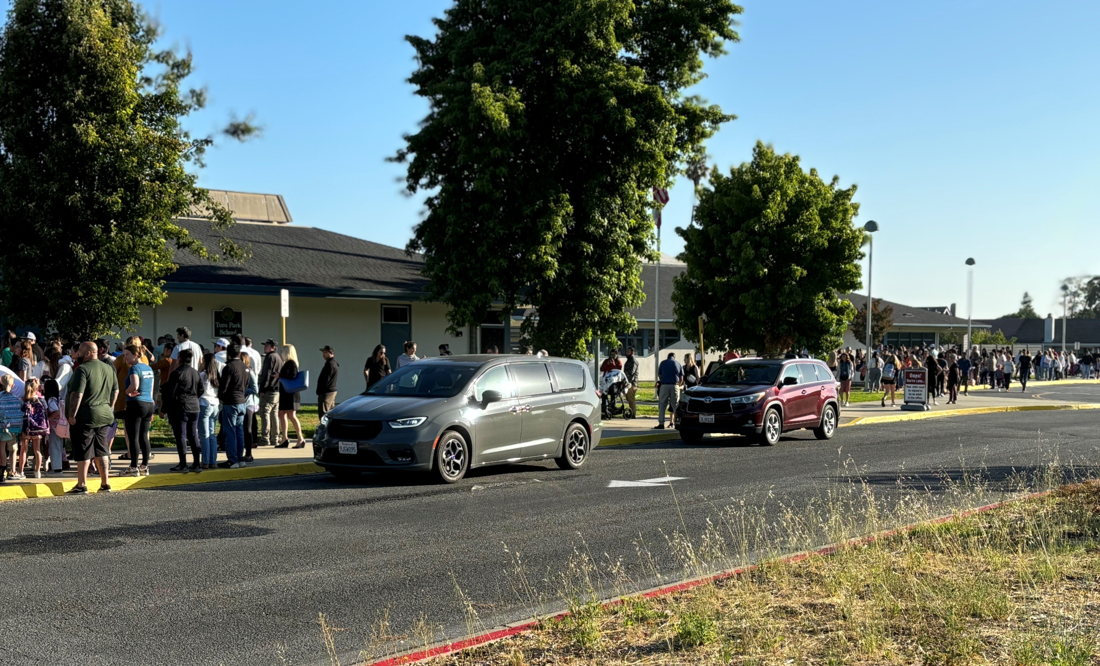
Project Schedule
21 Feb.
HOA asks for pilot project
3 Apr.
Community Kick-off Meeting
3 Apr. – 22 May
3 Committee Meetings
22 May
Community Consensus Meeting
26 June
TAMC funds Pilot Project
12 July
Phase I installed
25 July
School asks for a redesign of Drop-Off
7 Aug.
Opening day of school with improvements
27 Sep.
Phase II installed

Slide 8
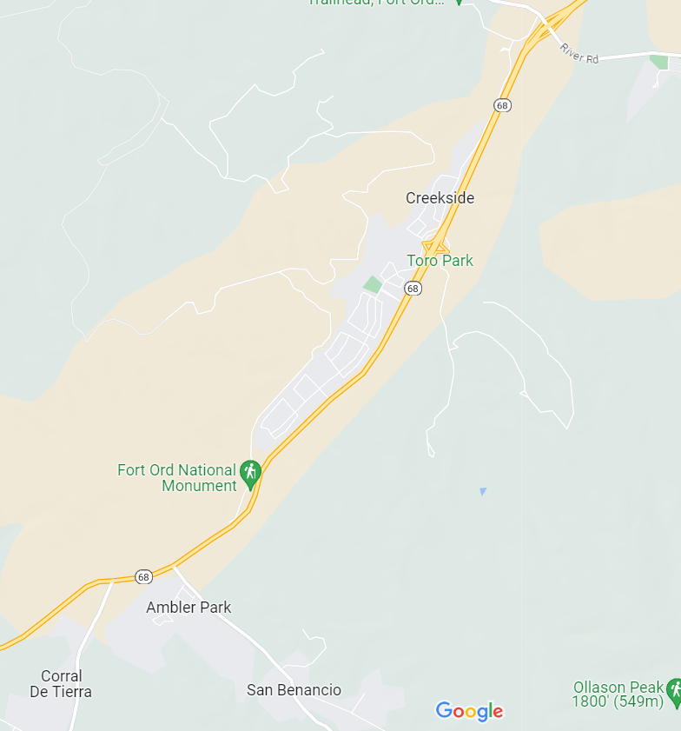
Blocking the cut-through traffic route?
528 Trips in AM Peak
Scenic Route 68 Corridor Improvement Project

Slide 9
Phase I:
Close Re-Entrance Point at Torero Drive
528 Trips in AM Peak
Scenic Route 68 Corridor Improvement Project

Slide 10
Toro Park Pilot Project
AM Peak Hour
Cut-Thru Traffic Solved!

Slide 11
Toro Park Pilot Project
Other Projects Rerouted Traffic to Hwy 68

Slide 12
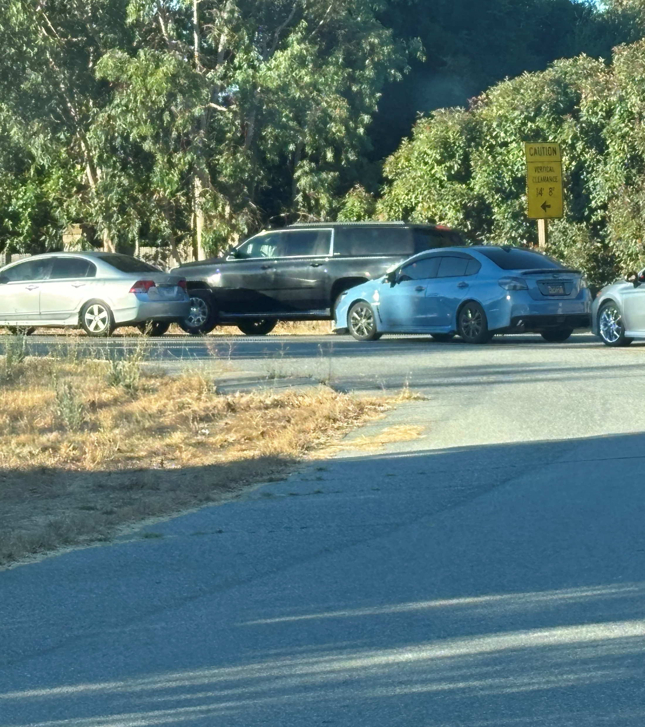
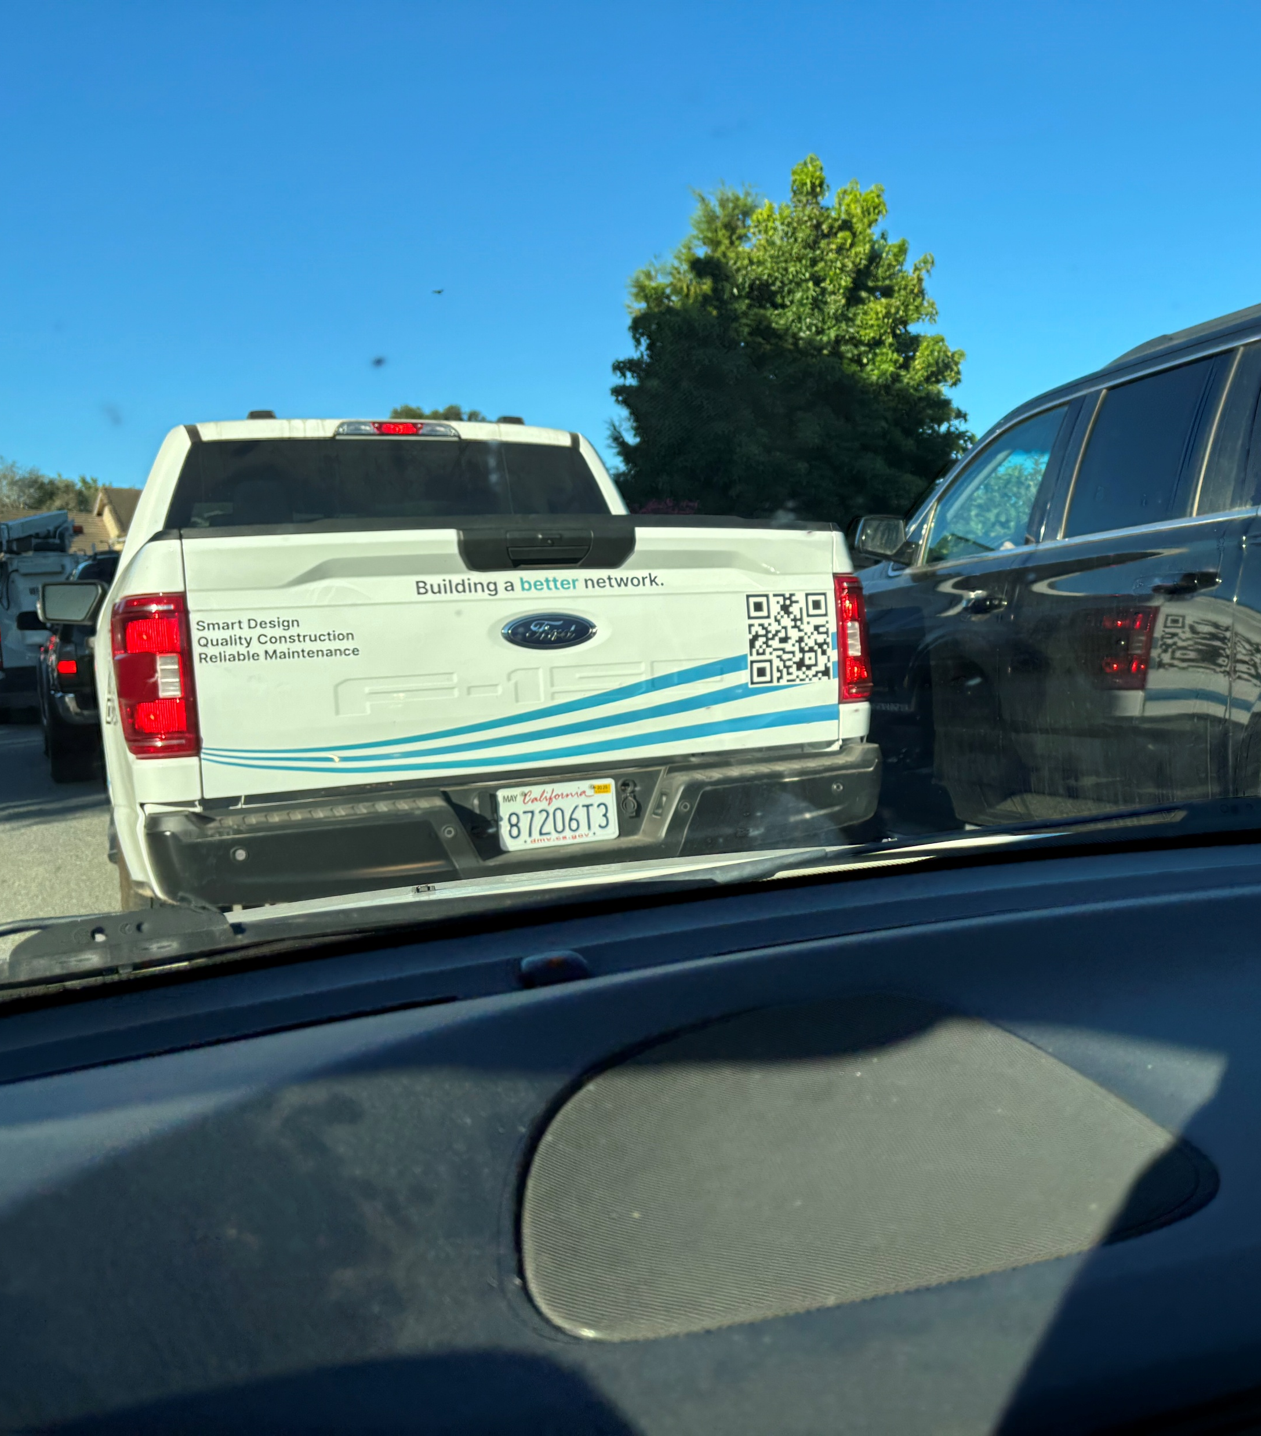
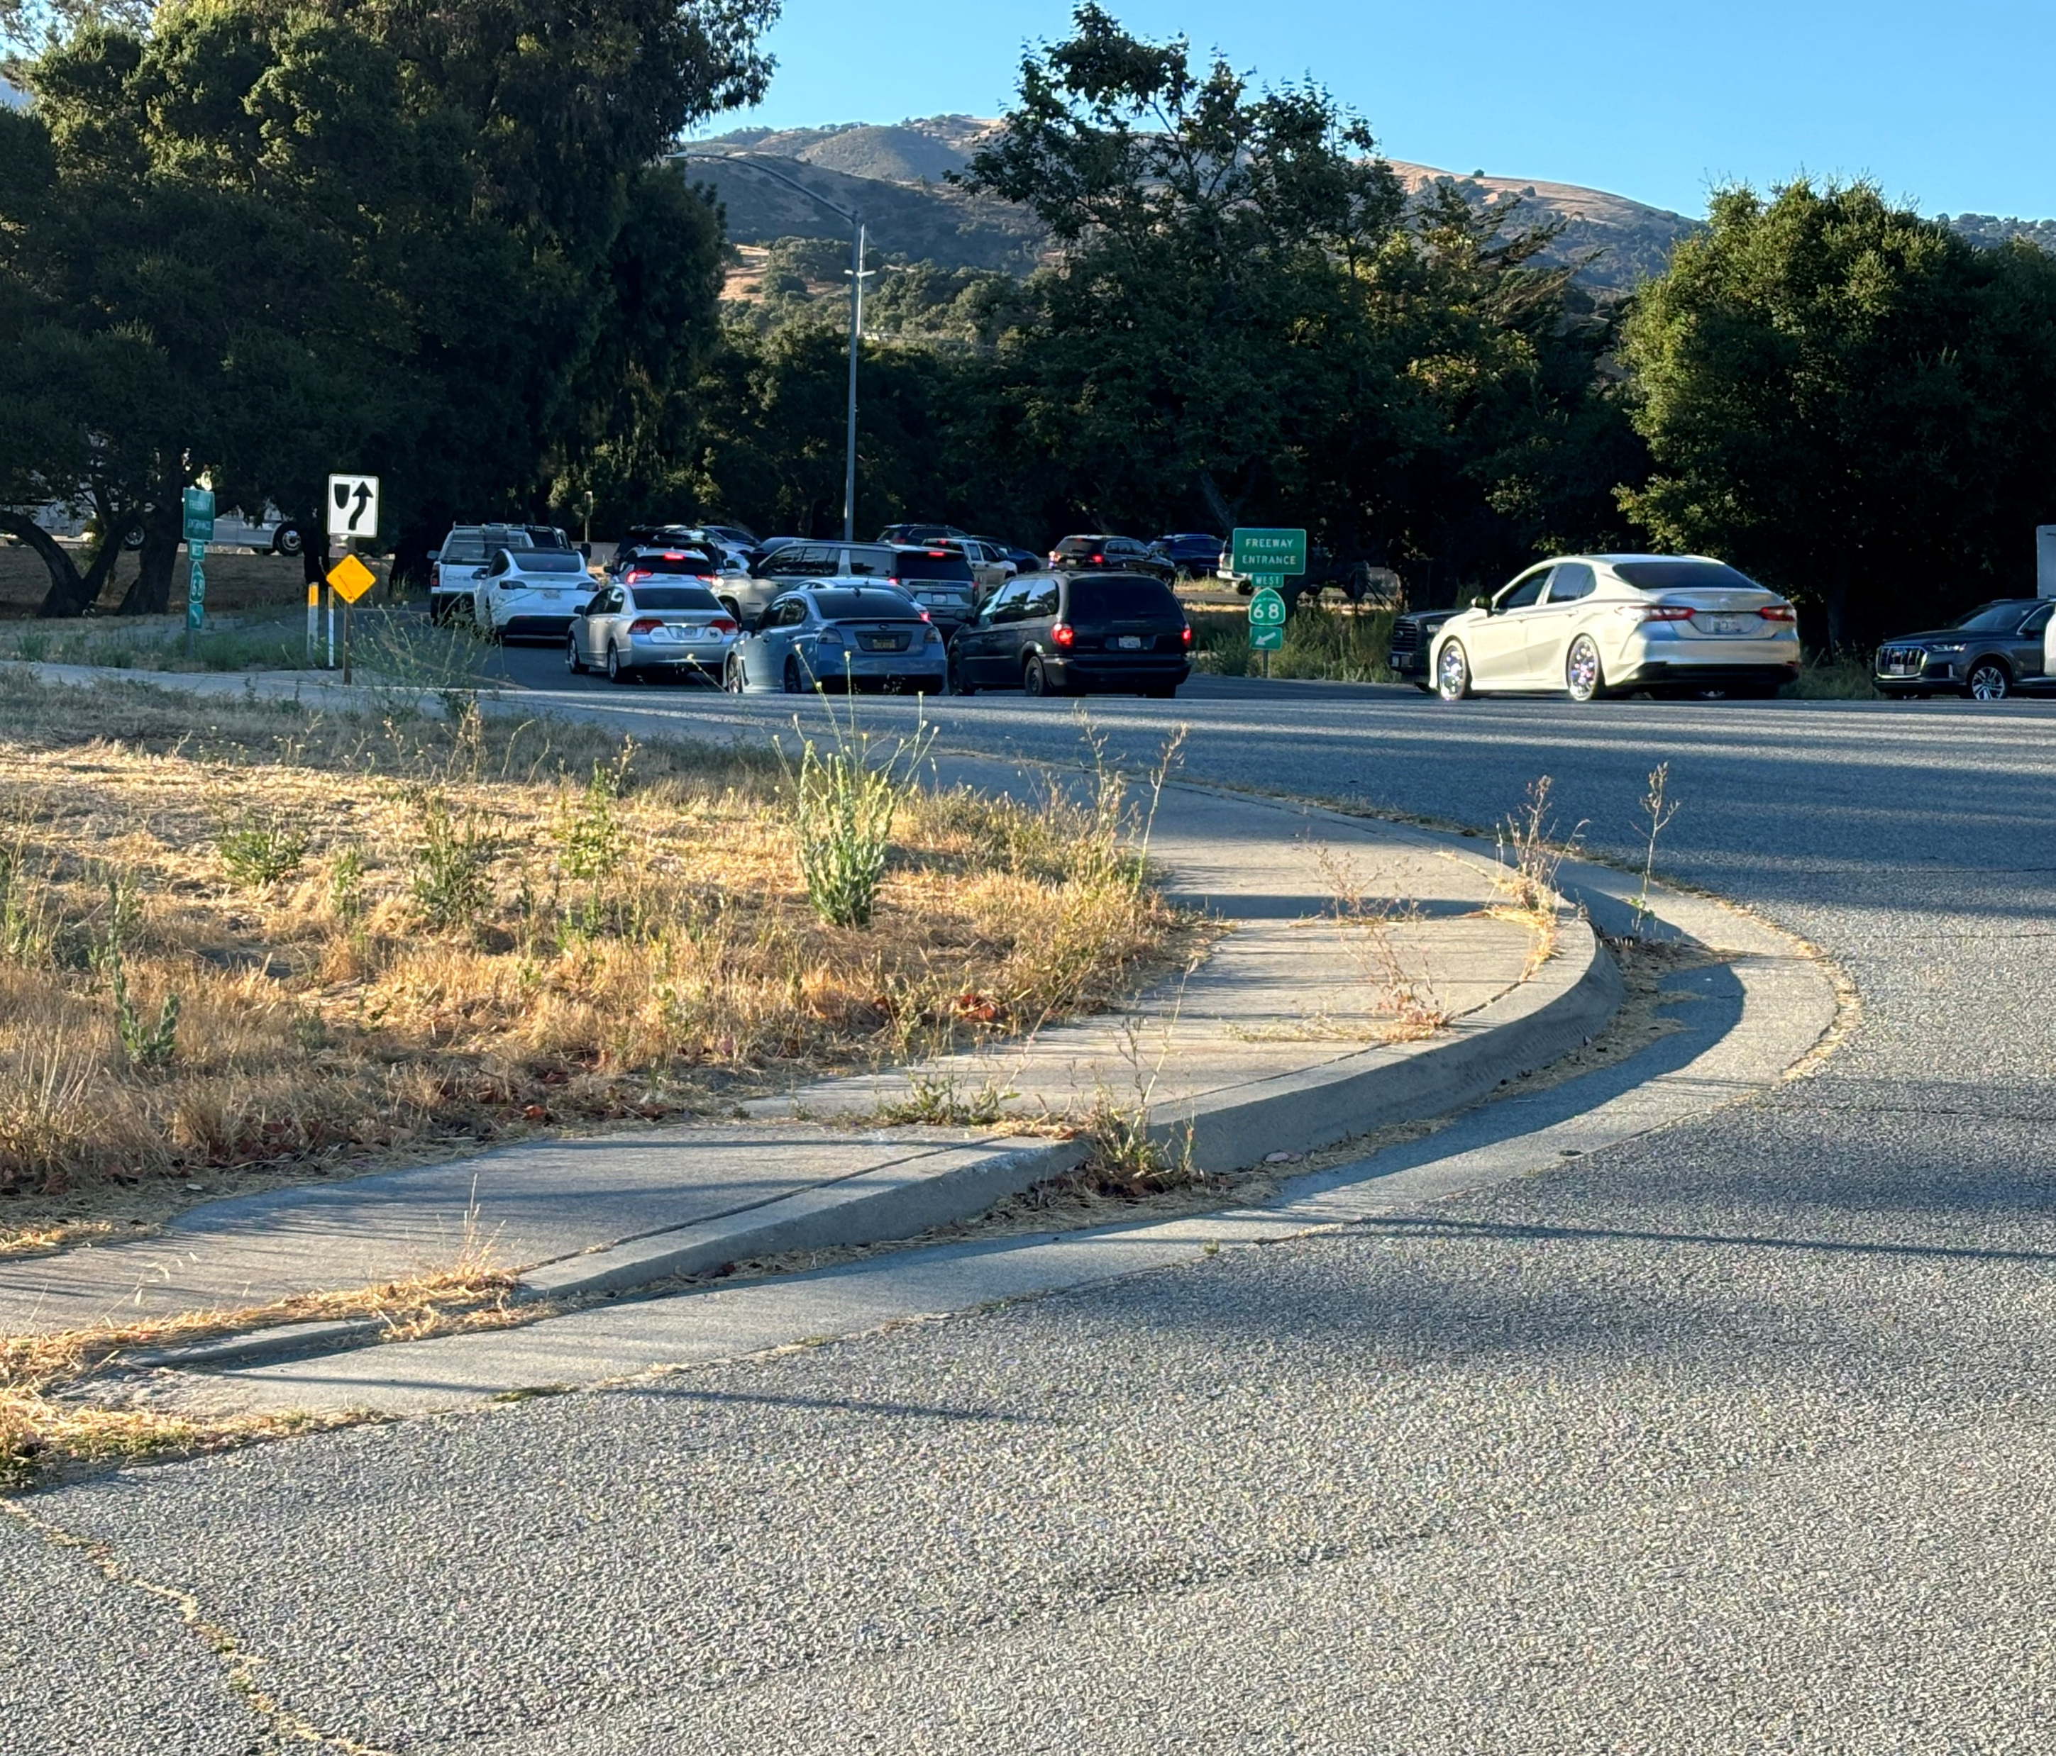
Yes We Needed Phase II

Slide 13
Phase II:
Close Portola Dr. Entrance from Hwy 68
152 Trips in AM Peak

Slide 14
Phase II:
Close Portola Dr. Entrance from Hwy 68
152 Trips in AM Peak

Slide 15
Pilot Project Feedback: Data Collection and Community Engagement
7 Aug.
First Day of School
7 Aug. – 20 Sept.
Monitor
8 Oct.
Community Workshop
27 Sept.
Phase II install
Oct. 1-Oct. 8
Monitor
23 Oct.
TAMC Board Meeting
Jan 15
Community Workshop
Jan 22
TAMC Board Meeting
July 12
Phase I installed
July 30
Monitor
November 8
Monitor

Slide 16
Toro Park Pilot Project Travel Time Runs
Route | Baseline target | Worse for school traffic | Worst for Hwy 68 | Current Trend
 | Phase I |  | Phase II
 | Davis Closed |  |  | Davis Open
 | Before School Opens | School Open
 | Signals Uncoordinated | Bad timing plan |  | Better Signal timing plan
Portola: Torero-Hwy 68 | 2:15-2:26 | 2:30-15:54 | 2:25 | 2:35-6:10
Hwy 68: Portola-Torero | 3:14-9:18 | 8:06-12:35 | 20:31 | 3:18-6:36
Typical Loop | 8:00 | 12:00 | 23:16 | 9:00
Worst Loop | 11:00 | 24:00 | 23:16 | 11:46

Slide 17
Toro Park Pilot Project Travel Time Runs
Route | Baseline target | Worse for school traffic | Worst for Hwy 68 | Current Trend
 | Phase I |  | Phase II
 | Davis Closed |  |  | Davis Open
 | Before School Opens | School Open
 | Signals Uncoordinated | Bad timing plan |  | Better Signal timing plan
Portola: Torero-Hwy 68 | 2:15-2:26 | 2:30-15:54 | 2:25 | 2:35-6:10
Hwy 68: Portola-Torero | 3:14-9:18 | 8:06-12:35 | 20:31 | 3:18-6:36
Typical Loop | 8:00 | 12:00 | 23:16 | 9:00
Worst Loop | 11:00 | 24:00 | 23:16 | 11:46

Slide 18
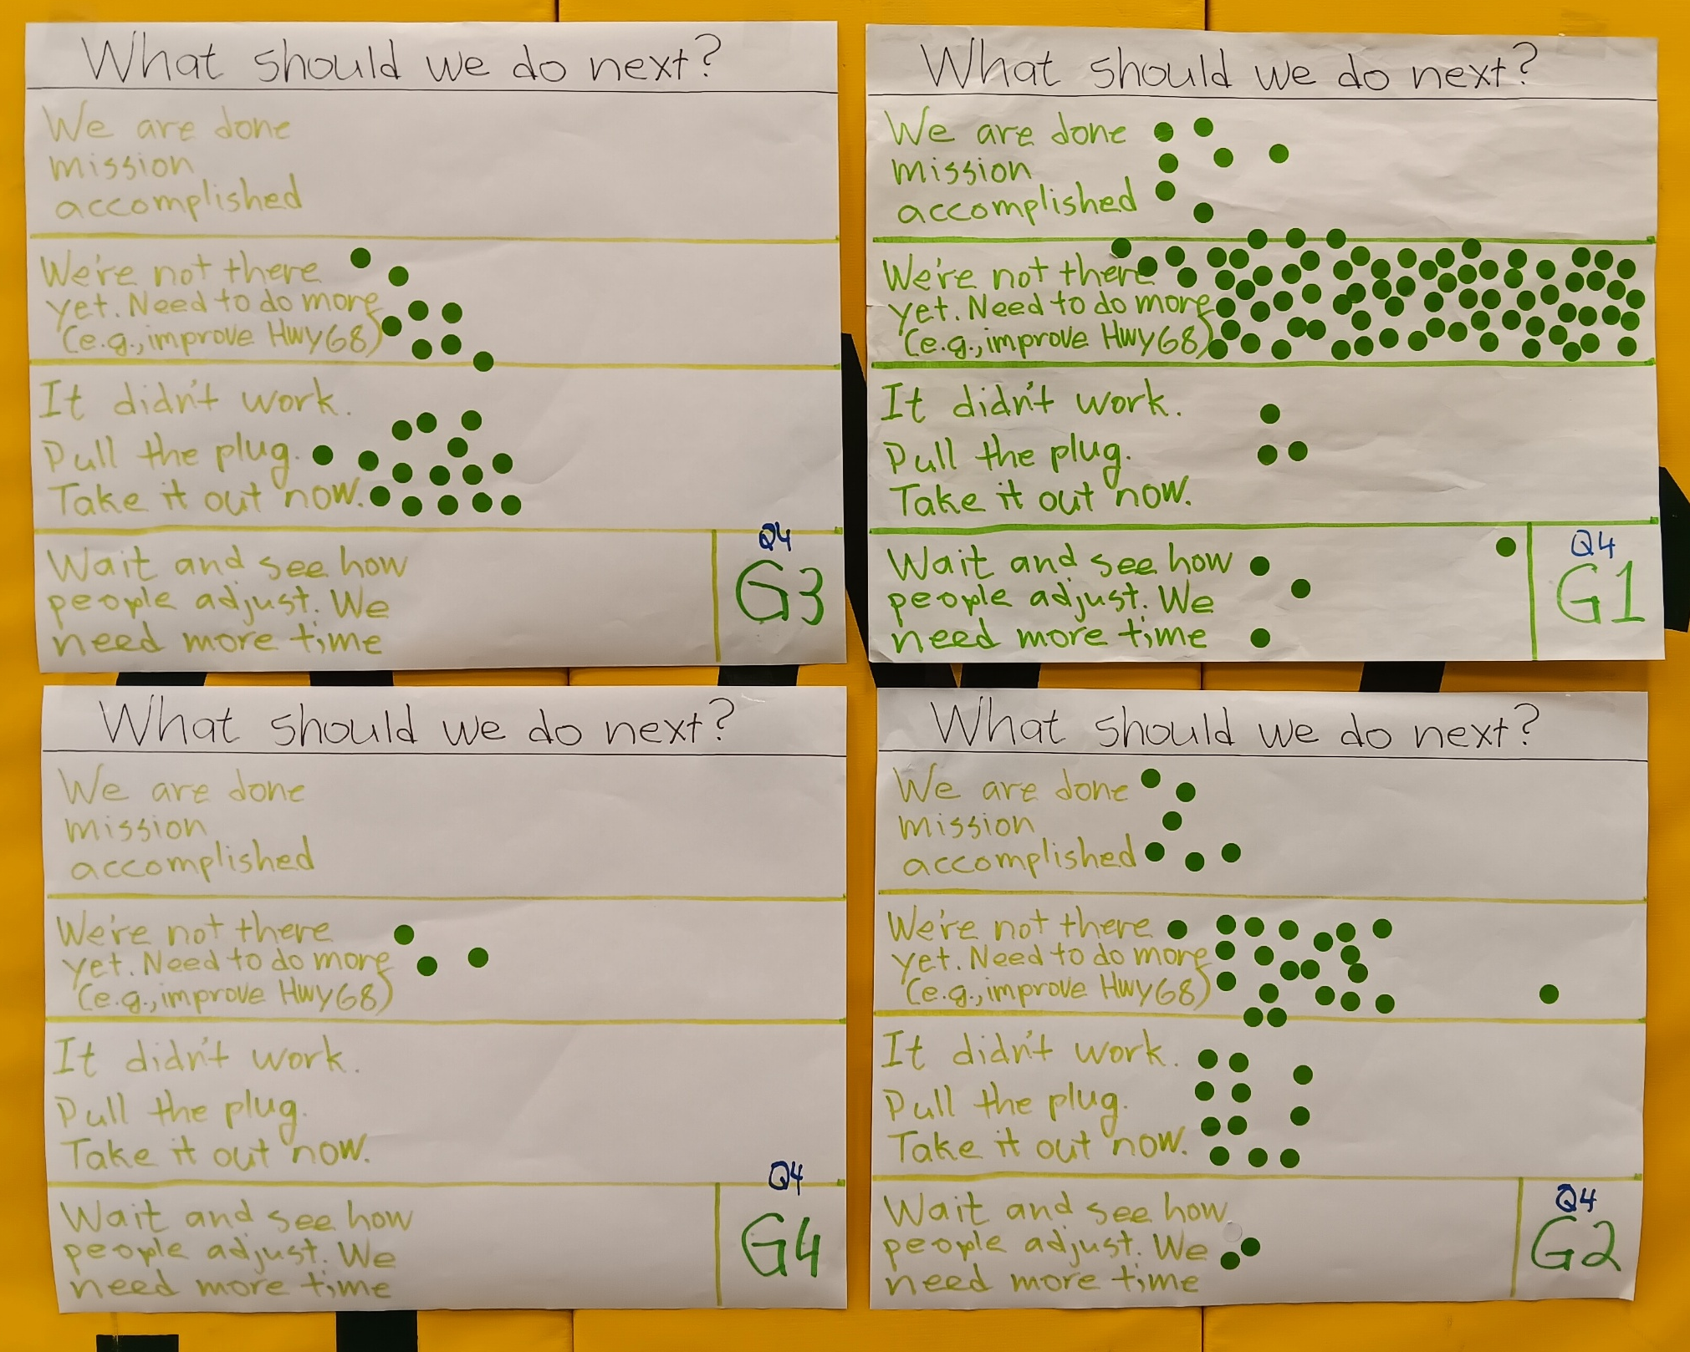
October 8 Community Workshop Results

Slide 19
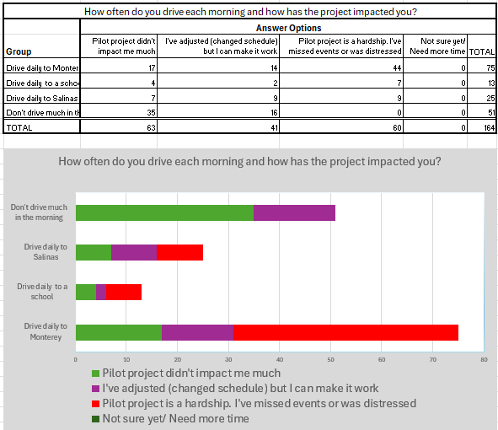
59%
37%

Slide 20
We Heard You Loud and Clear!
Phase I doesn’t work for West Toro or school
Phase II is too close to Creekside residences
Congestion limited to a few hours- solution should be too!
Fund permanent improvements
Make it look nice
Notes:
How can we do better?

Slide 21
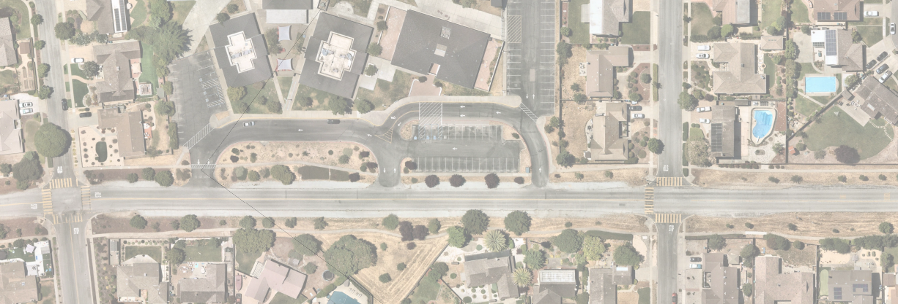
Phase I: Torero Drive Relocation

Slide 22
Torero Drive Relocation: No Gate
School Traffic Only
Busses Only
Buss & cars

Slide 23
Torero Drive Relocation: With Gate
School Traffic Only
Busses Only
Buss & cars

Slide 24
January 15 Workshop Results Torero Drive Partial Road Closure
Relocate closure to School Entrance:
 | All | 64%
 | West Toro Park | 70%
Install gates when possible:
 | All | 85%
 | West Toro Park | 75%
Remove road closures/Kill project:
 | All | 8%
 | West Toro Park | 16%

Slide 25
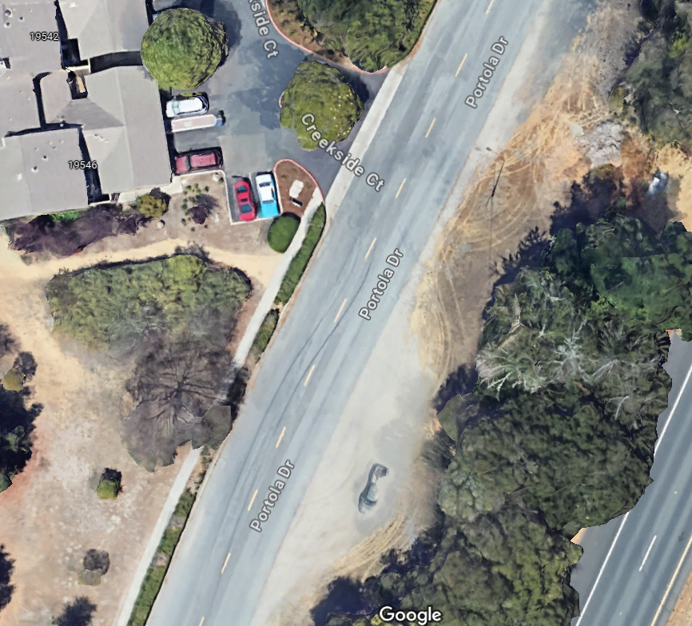
Phase II:
Relocate Creekside

Slide 26
Relocate Creekside
No Gate

Slide 27
Relocate Creekside
With Gate

Slide 28
January 15 Workshop Results Creekside Partial Road Closure
Relocate closure to School Entrance: 89%
Install gates when possible: 82%
Remove closures/Kill project: 10%

Slide 29
How do we fund this?
Include safe routes to school features
Include multimodal path
Tie improvements into State Route 68 Roundabout Project
Notes:
New years resolution
Make good decisions quickly
Dry January

Slide 30
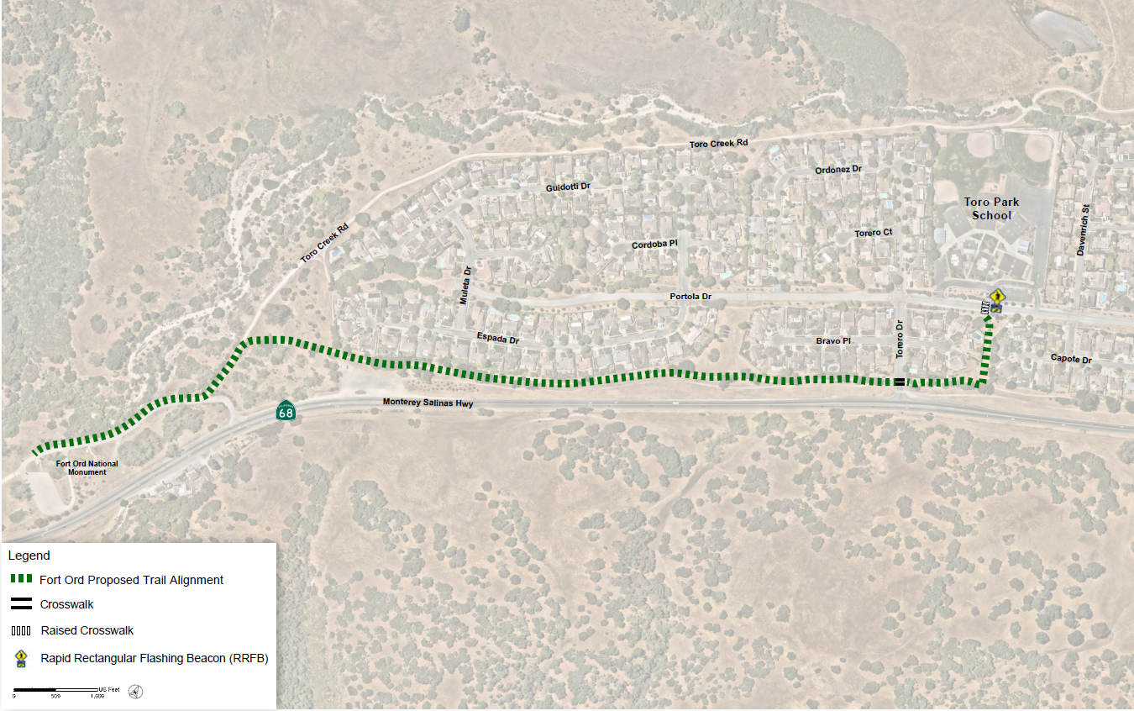
ADA Multi-Use Path School to Fort Ord National Monument & Laguna Seca
Raised Crosswalk at school entrance

Slide 31
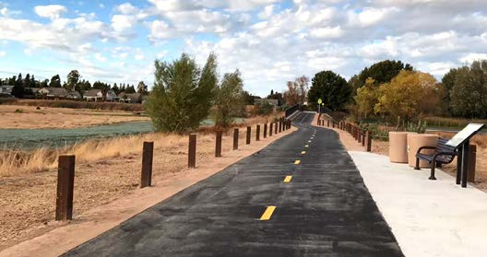
Multi-Use Path

Slide 32
Where do you live, and do you support a Multi-Use Trail?
Do you like the idea of constructing a formal trail so that all users can enjoy it (ADA accessible)?
90% agree
Should it connect the school to the Fort Ord National Monument parking lot?
84% agree

Slide 33
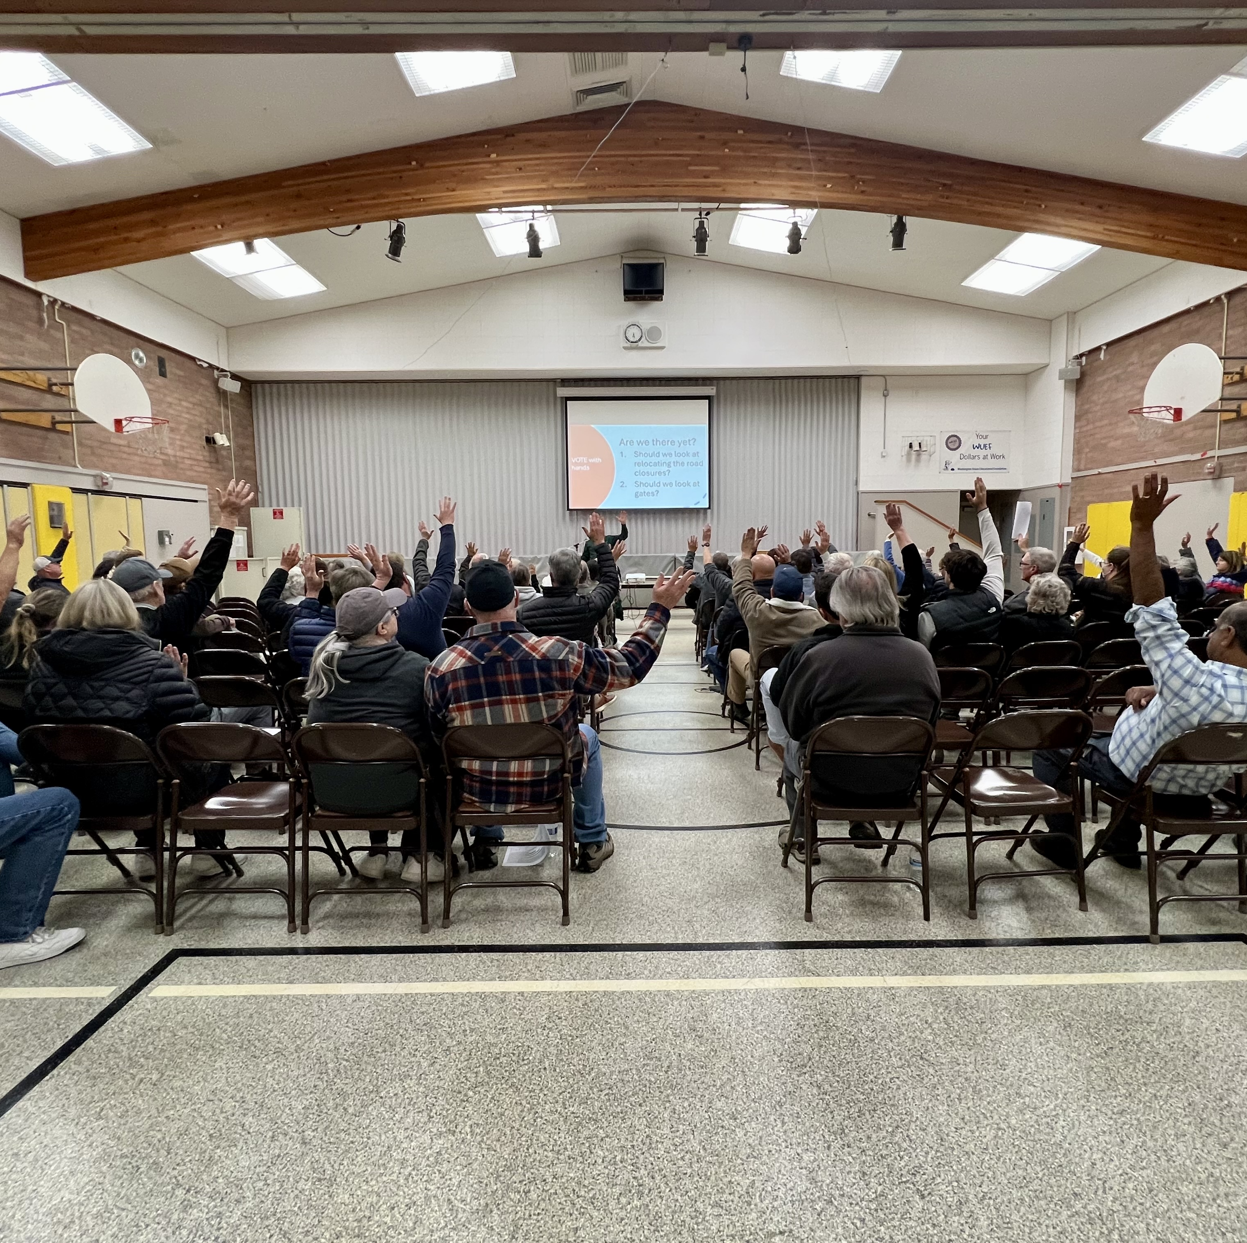
Most important votes from January 15 workshop
Are we heading in the right direction?
YES
If we install gates at new locations, is adding 8-12 minutes to morning trips to Monterey Peninsula a fair trade-off for eliminating cut-thru traffic?
YES
Did we hear you?
YES

Slide 34
What is left?
Get feedback from TAMC Board on January 22
Hand off project to County Public Works
Complete technical report and submit to County Public Works
Coordinate work with County staff to implement interim solutions
Work towards funding permanent solutions as part of SB-1 grant

Slide 35
Recommendations for Technical Study
Relocate Phase I Partial Road Closure to School Entrance
Relocate Phase II Partial Road Closure Closer to Fire Station
Research and implement movable barricades (gates)
Upgrade devices to create a residential character
Work with County staff on a 6-month transition plan using remaining funds

Slide 36
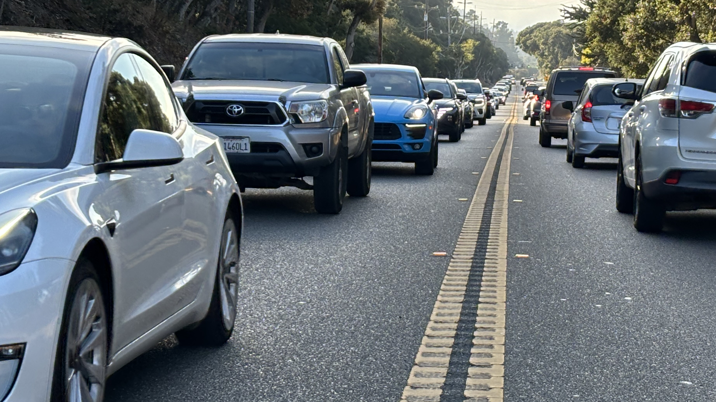
Questions

Slide 37
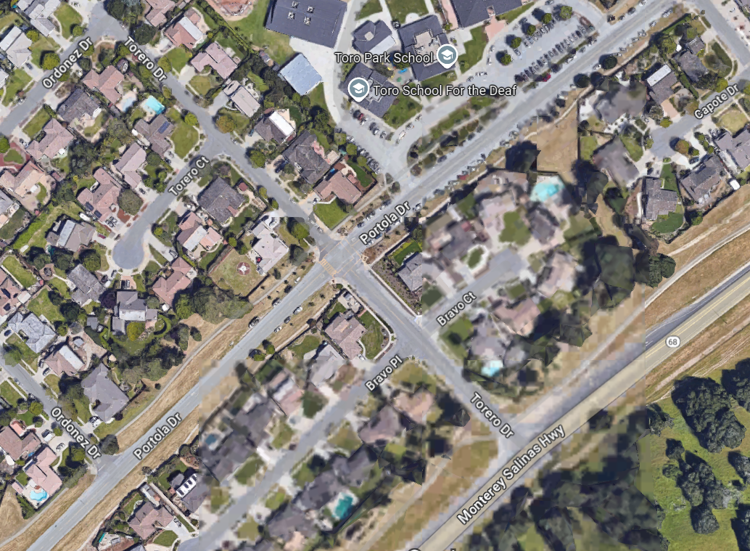
Raised Crosswalk
Crosswalk

Slide 38
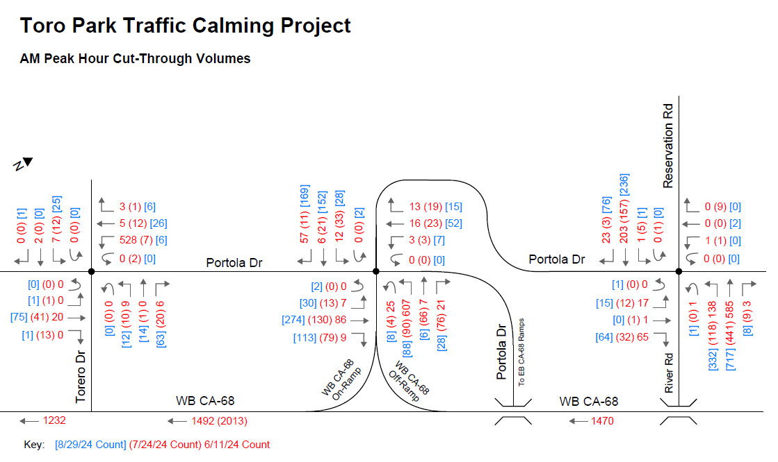
Add Graph of traffic counts

Slide 39
Criteria for Partial Road Closure
Must block cut-through traffic during AM Peak Hours
One must maintain access to school without forcing parents to make a left turn from Hwy 68 to Torero Drive
One must be east of fire station
Must be at an intersection
Design vehicle (FedEx truck) must be able to make a U-Turn
Ideally there is general agreement on location
Looking at Bus-Activated gate option for long-term alternative to partial road closure

Slide 40
What is traffic doing to our community? Quality of Life issues
45 minutes to drop off students (stress)
Safety on side streets (roads not designed for this type of traffic)
Speeding, aggressive drivers and hostility (can’t walk peacefully in the mornings)
Feel land-locked
Need to reschedule appointments because can’t exit driveway or use Portola Drive
Noise (don’t need a clock to know when school starts)
Commercial trucks have no business on our streets
Emergency response
Home values suffer from congestion

Slide 41
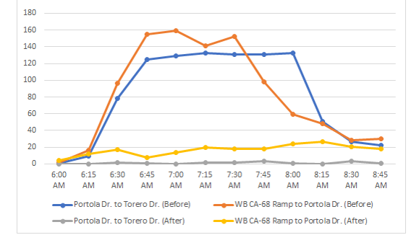
Portola Drive: Cut-Through Traffic 15-Min Counts

Slide 42
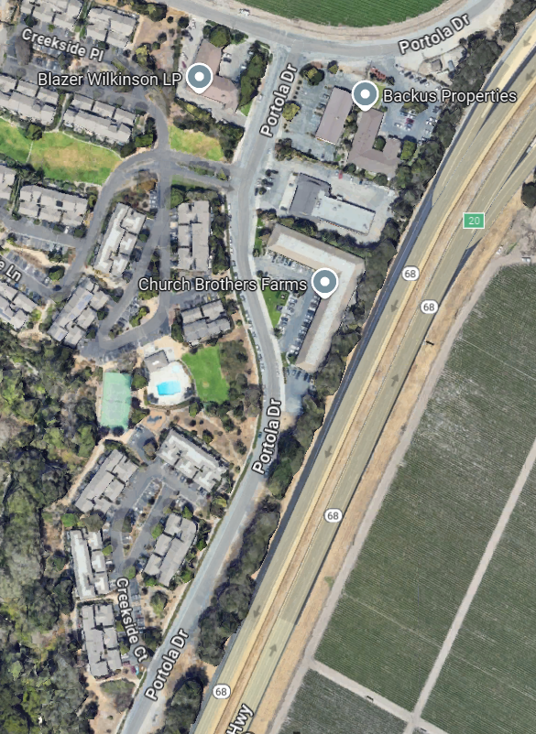
Attachment 3: Phase II (Creekside)

Slide 43
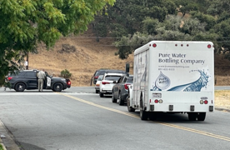
What Happens If You Ignore the Signs?

Slide 44
BEFORE
AFTER
152 Trips
0 Trips
22 Trips
24 Trips

Slide 45
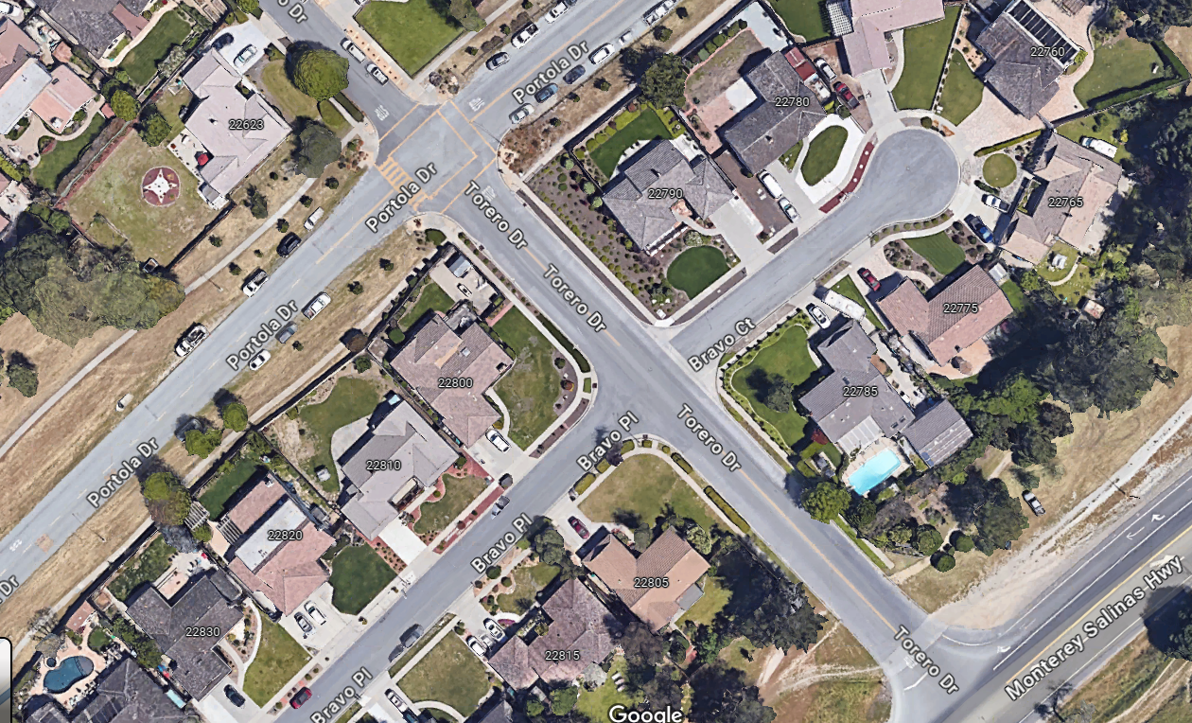
BEFORE
704 Trips
1232 Trips
528 Trips
0 Trips
AFTER

Slide 46
Attachment 2: Phase I (Torero Drive/Bravo Court)

Slide 47
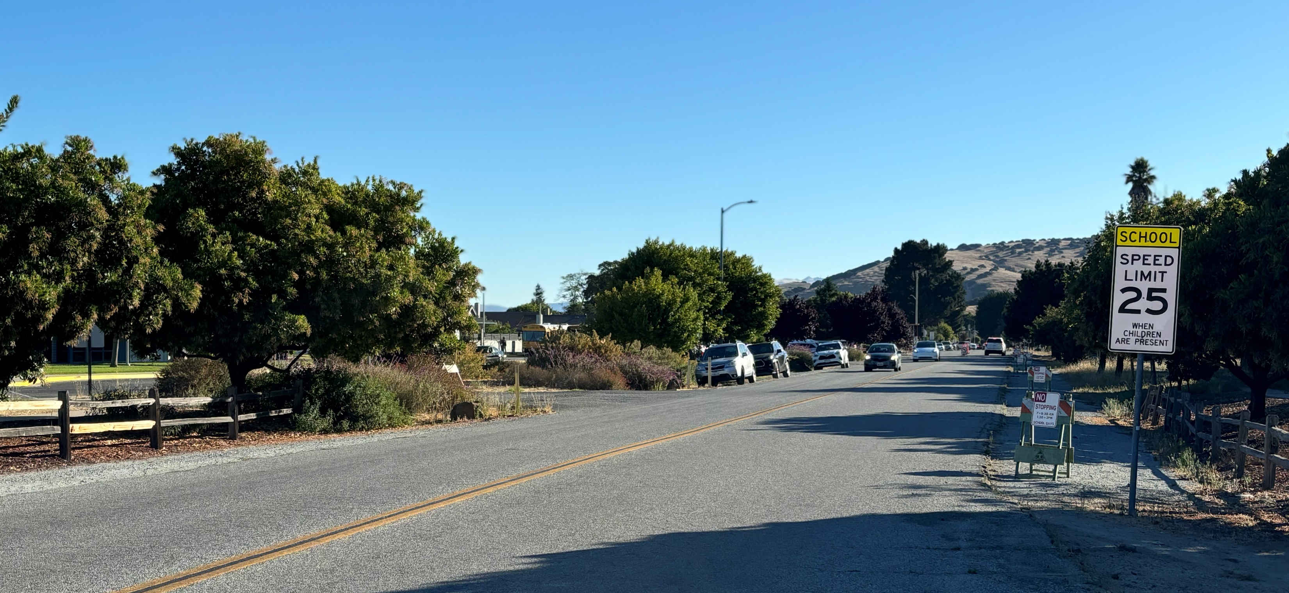
Make it look nice!

Slide 48
What Happened Since October 8 Workshop?
Caltrans traffic signals coordinated better on Highway 68
Caltrans continues work implementing adaptive/AI signals
Caltrans rejected idea to relocate the merge from current location to east of Portola Interchange
Davis Road was re-opened
Meet with stakeholders to identify feasible alternatives
TAMC collected traffic data

